Slide 1
Indicator Compliance-Related Reports
Wyoming Special Education Data Share-Out Reports

Slide 2

Who Am I
Suzy Wagner, Ph.D.
President,
Data Driven Enterprises
www.DataDrivenEnterprises.com

Slide 3
WDE

Slide 4
Objective
Walk you through your Indicator Compliance-Related Reports on WY SPED-Link

Slide 5
Reports to Download
Report Cards/Trend Reports
Topic Area Reports
Indicator Reports
Curiosity Report
Overview (State only)
Guided Activities (State Only)
Your 2021-22 Reports
WY
SPED-LINK Site
Notes:
Suzy

Slide 6
Your 2021-22 Reports
Indicator Compliance-Related Reports
I4: Discipline Report
I9/10: Disproportionate Representation
I11: Timely Evaluation
I13: Secondary Transition

Slide 7
Where are the reports?
WY SPED-Link Site
https://wde.ddehome.com/

Slide 8
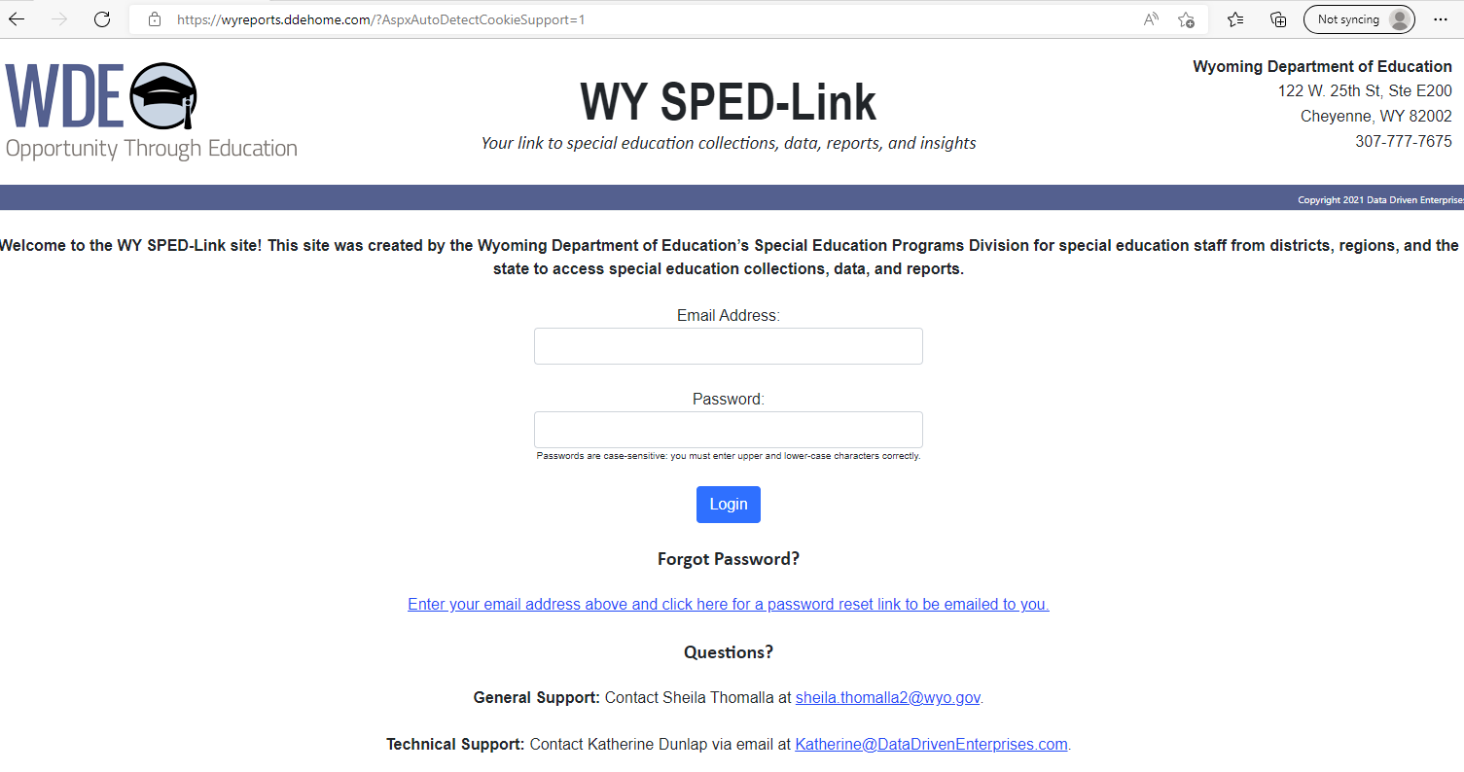
WY Reports Site

Slide 9
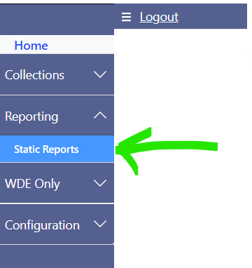
WY Reports Site

Slide 10
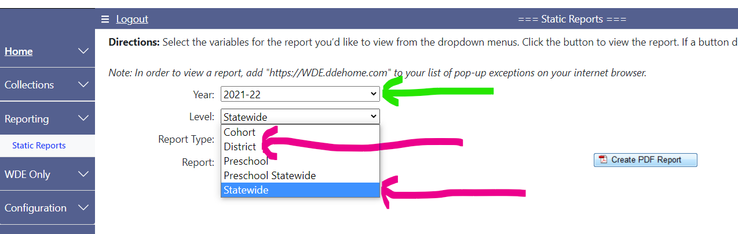
WY Reports Site

Slide 11
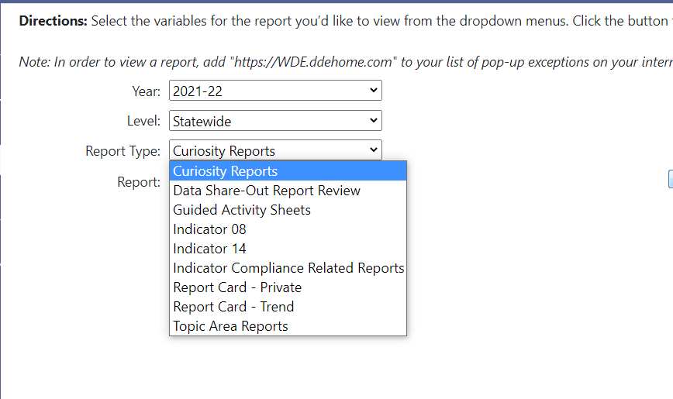
WY Reports Site
Notes:
Carol Updated

Slide 12
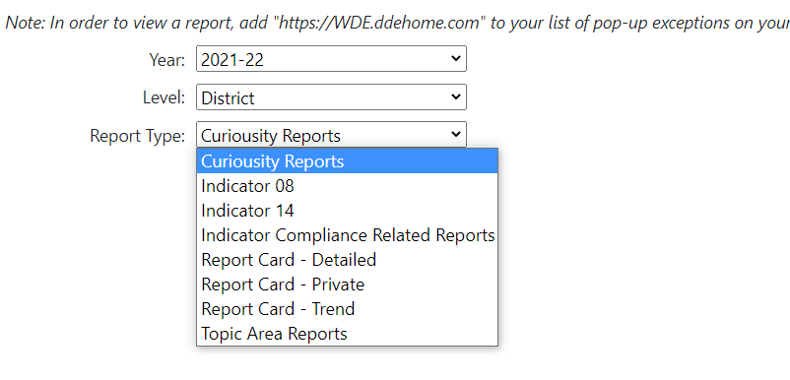
WY Reports Site
Notes:
Carol Updated

Slide 13

Thank You!

