Slide 1
Educating Deaf/Hard of Hearing Students:
Beginning with the
End in Mind
WDE: Janine Cole, Billie Wortham, Christie Fritz

Slide 2
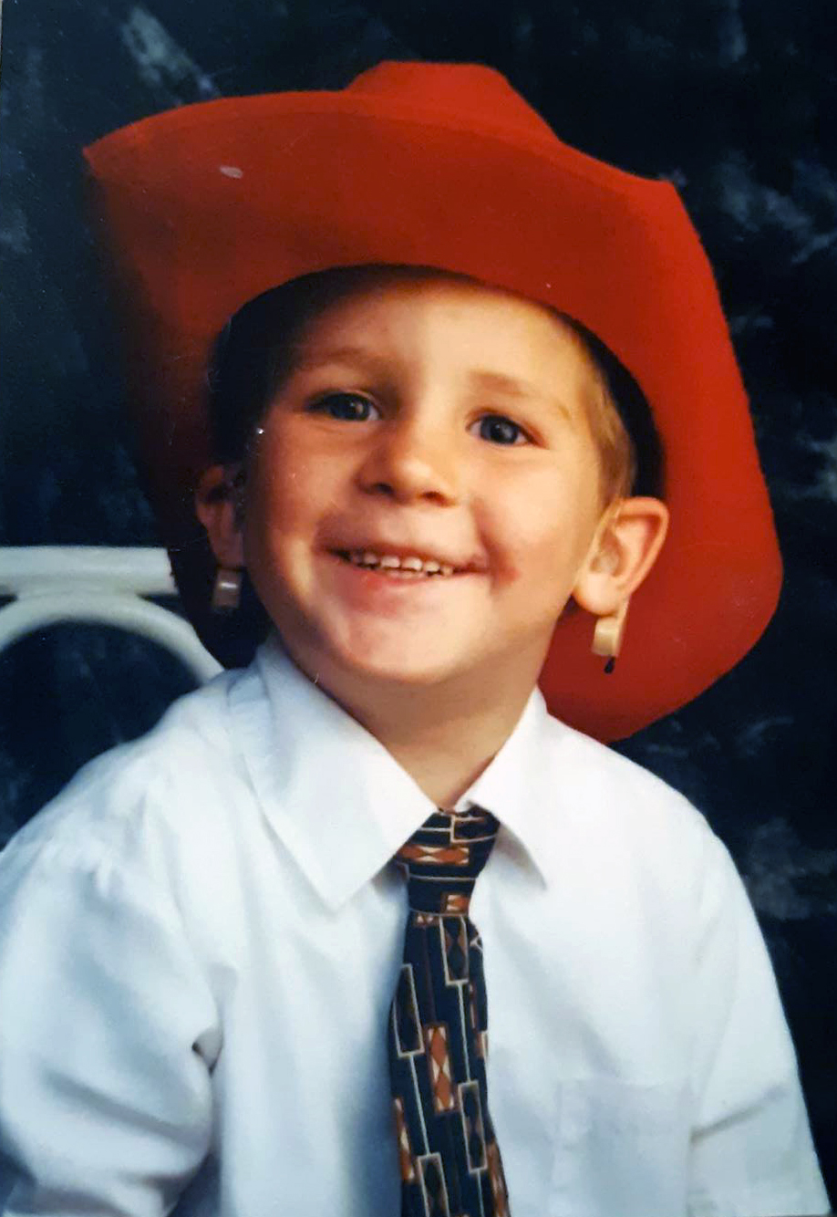
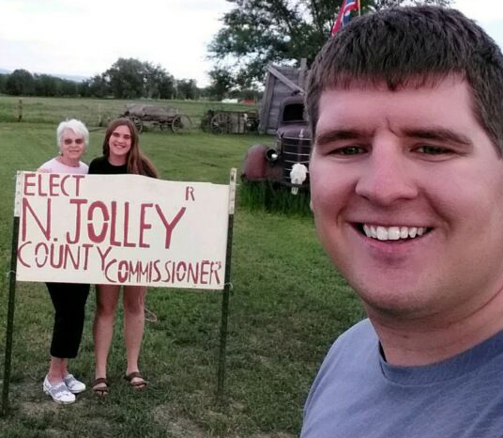
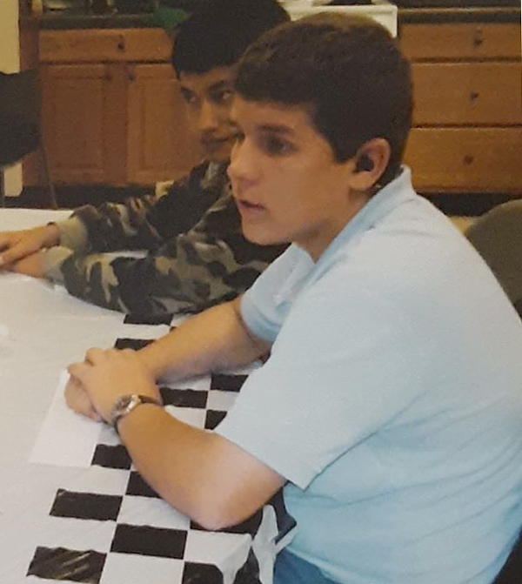
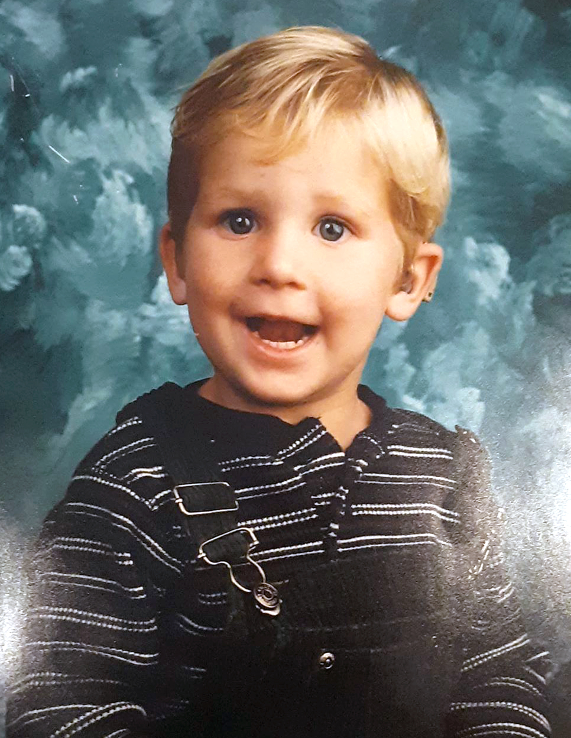

Slide 3
(GR Pictures)

Slide 4
Pieces to the puzzle
Transition
K-12
Supports
Early
Identification
Early
Intervention

Slide 5
Early
Identification
Piece

Slide 6
Early Identification Includes
Identifying Hearing Loss Early
Helping Families Understand
The Hearing Loss

Slide 7
Why is Early Identification Important?
Decrease Long Term Impacts of Hearing Loss On:
Learning, Communication, Relationships, Employment
Early Identification Allows Time for Parents To Be Educated/Trained About Options For:
Communication, Technology, Education

Slide 8
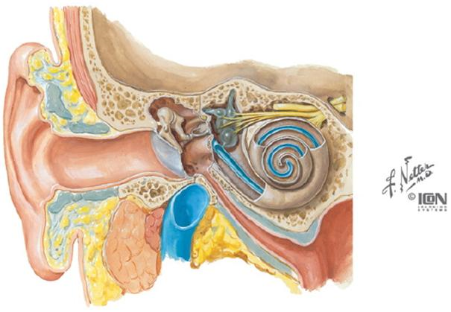
Ears are like the keyboard entering information that is heard.
How Hearing Works

Slide 9
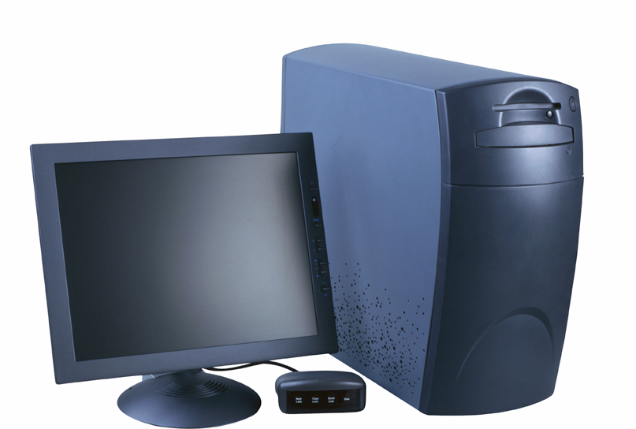
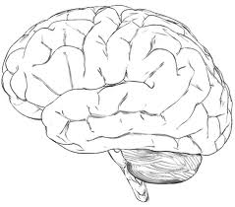
Brain is like the hard drive processing what is heard.

Slide 10
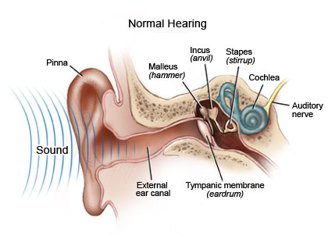
The Ear

Slide 11
Cochlea

Slide 12
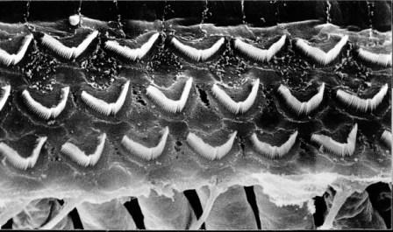
Hair Cells Determine Clarity of Sound
Hair Cells Inside a Cochlea

Slide 13
Damaged Hair Cells

Slide 14
Audiogram

Slide 15
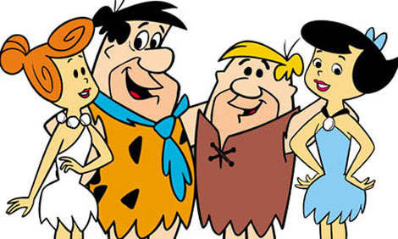
Example of Hearing Loss
http://www.youtube.com/watch?v=TD5E88fFnxE

Slide 16
Early
Intervention
Piece

Slide 17
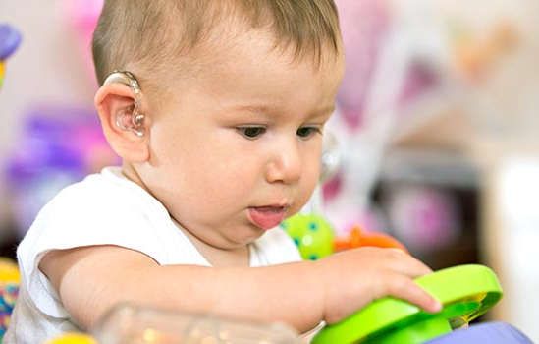
Early Intervention: Providing Services Birth to 5 years
Exploring Communication Options
Audiological Evaluation- Fitting Technology
Comprehensive Evaluation (0-3) (3-5)
Specialized Supports/Instruction

Slide 18
Assemble a Qualified Team
Audiologist
Teacher of the Deaf
Speech-Language Pathologist
Early Interventionist
Others?

Slide 19
Services The Team Can Provide:
Supports to Families (training, information)
Comprehensive Evaluations
Specialized Instruction: Language, Listening, Academic, Sign or Oral Communication, Social Skills, Self Advocacy
Notes:
J9

Slide 20
Communication Options

Slide 21
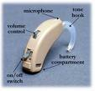
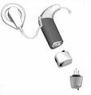
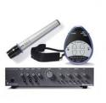
Technology Options
Hearing Aids
BAHA
Cochlear Implants
Personal FM systems
Classroom Amplification Systems

Slide 22
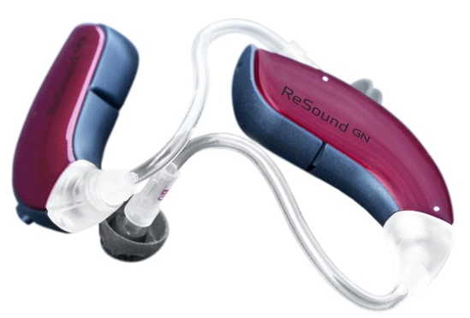
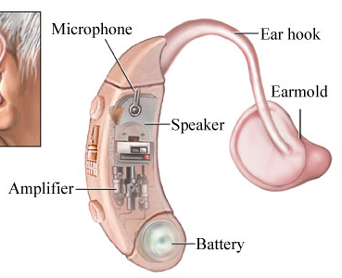
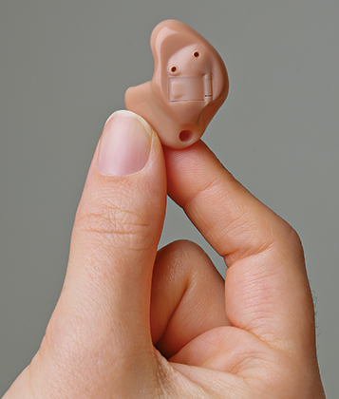
Personal Hearing Aids

Slide 23
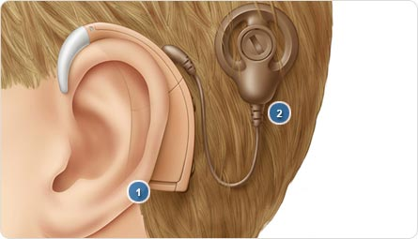
Cochlear Implant

Slide 24
Notes:
CI simulation here?

Slide 25
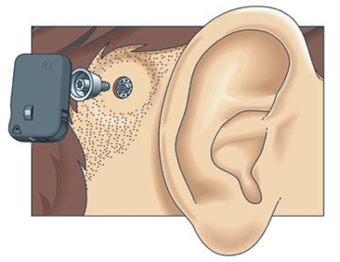
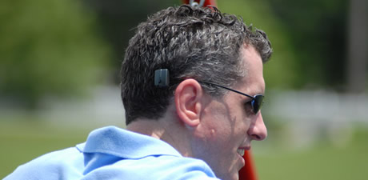
BAHA

Slide 26
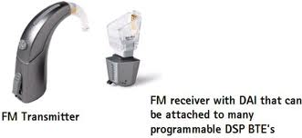
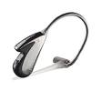
Personal FM Options
FM Transmitter
FM Receivers for hearing aids, cochlear implants,
and FM only

Slide 27
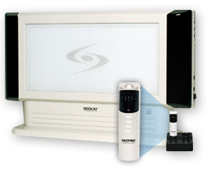
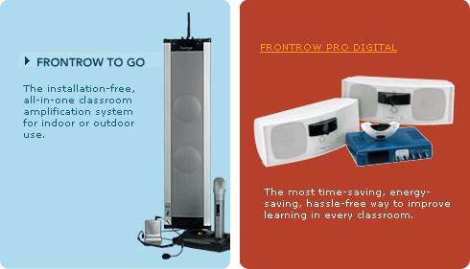
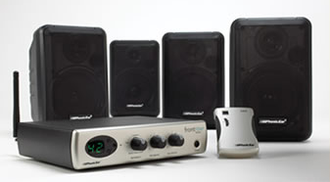
Portable/Room Speaker System

Slide 28
K-12
Piece
Notes:
J9

Slide 29
K-12 Supports
Appropriate Technology
Knowledgeable Providers
Comprehensive Evaluations
Programming for Needs
Accommodations/Supports (interpreters, technology, specialized instruction)
Notes:
Specific to related services, Sped services

Slide 30
Assemble a Qualified Team
Audiologist
Teacher of the Deaf
Speech-Language Pathologist
Special Education Teacher
General Education Teacher
Administrator
Interpreters
Others?

Slide 31
Services The Team Can Provide:
Supports to Families (training, information)
Comprehensive Evaluations
Specialized Instruction: Language, Listening, Academic, Sign or Oral Communication, Social Skills, Self Advocacy
Assistive Technology Guidance: Captioning, Assistive Listening Devices, Communication Devices
Notes:
J9

Slide 32
Because the Impacts Are Long Term
Why are these services critical?
Listening Skills
Speech and Language
Academics/Reading
& Writing
Social Emotional
Early
Sign Skills
Graduation

Slide 33
https://www.youtube.com/watch?v=9vqY7cJpwRs&list=PL_jg9VvIO0LTlYCFBiJm7ejcOD8EvDYYQ

Slide 34
Spelling Words through Simulated
Hearing Loss above 1000 Hz
1.
125
250
500
1000
2000
4000
8000
2.
0
3.
10
20
z
v
4.
p
30
h
g
j
mdb
ch
5.
40
n
l
sh
ng
o
a
r
HEARING LEVEL (dB HL)
e i
50
u
6.
60
70
7.
80
8.
90
100
9.
110
120
10.
AUDIOGRAM OF FAMILIAR SOUNDS
FREQUENCY IN CYCLES PER SECOND (HZ)
Click on Speaker to
Present Spelling word.
Notes:
34

Slide 35
Educational Strategies
Inservice Trainings to Providers
Pre and post teaching
Strategic Seating
Repeating/Summarizing Peer Responses
Reduce Background Noise
Provide Additional Wait-Time for Processing
Use Visuals (pictures, drawings, objects, pointing, gestures, signs)

Slide 36
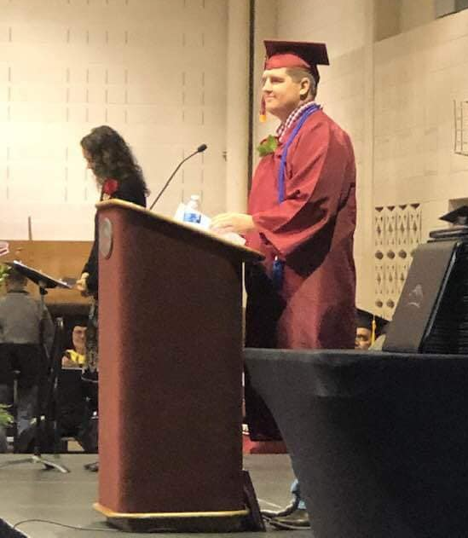
Transition
Piece

Slide 37
Transition defined:
“Process or period of changing from one state or condition to another”
Note: In the State of Wyoming the transition IEP is to be in place by the time the student turns 16 years old
Notes:
Discuss periods in life where the are transitions……some small some big. Examples starting kindergarten, starting high school, getting married, having kids. How do we prepare for these? What knowledge and skills are needed for these transitions?

Slide 38
Transition: High School and Beyond
Connected with Services
Understanding Rights
Self Advocacy
Identifying Own Needs
Solid Transition Plan

Slide 39
Assemble a Qualified Team
Audiologist
Teacher of the Deaf
Speech-Language Pathologist
Special Education Teacher
General Education Teacher
Administrator
Interpreters
DVR Counselor
Transition Coordinator

Slide 40
Process of Transition in School
Assessment
Develop goals post H.S.
Course of study to reach goals
Monitor progress Annual IEP
Refine/revise based on new information
Notes:
This a question bank that can be used for parents and providers.

Slide 41
Indicator 13 34 CFR 300.43
Secondary Transition
Regulations state:
A coordinated set of activities that are results oriented, individualized, includes related services, community experiences, daily living skills and employment.
Notes:
What does the Federal Law under the IDEA require? This is condensed version. Does not apply to 504 students.

Slide 42
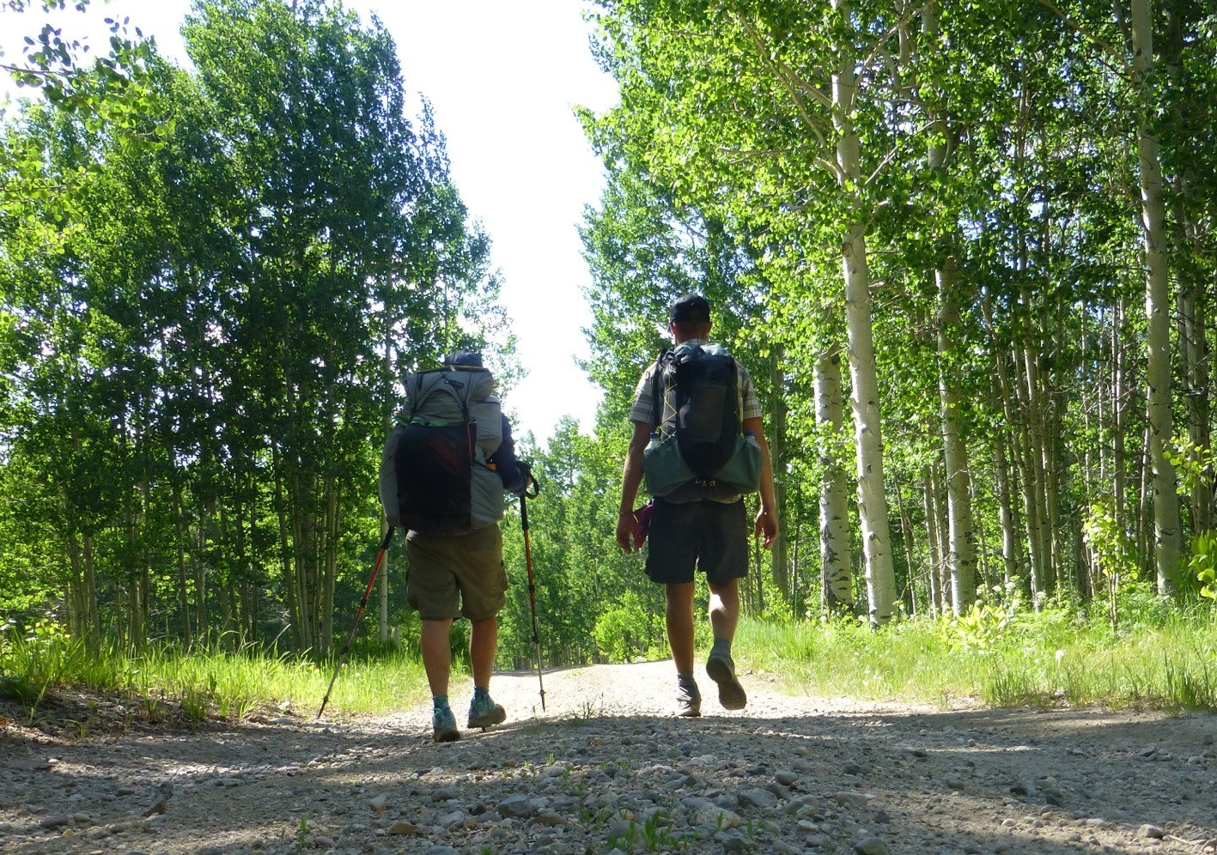
Transition in Wyoming
Critical to connect transition assessment with post-secondary goals.
As part of our general supervision the State Department of Education reviews transition plans.
Most issues we see are a disconnect between the transition assessment and the post-secondary goals.
Example of a Post-Secondary Goal: After graduation, Joey will enroll, attend, and complete a training program in culinary arts.
Examples of a Transition Activities:
1. Joey will research 3 potential culinary arts programs.
2. Joey will identify accommodations/supports he might
need while attending a culinary arts program.
3. Joey will meet in person or via technology with a
disabilities coordinator to ask questions and gain
information about provision of accommodations.
4. Joey will meet with a DVR Counselor to gather
information about services DVR can provide to
support his program attendance.
Notes:
Discuss this in terms of what the student is capable of, wants to do and what is realistic or pertinent.

Slide 43
Annual Transition Training for Deaf/Hard of Hearing Students
Scheduled for December 2019
at Casper College
Targeting: Students, Parents, Providers, Agencies

Slide 44
Pieces to the puzzle
Transition
K-12
Supports
Early
Identification
Early
Intervention

Slide 46
Resources

Slide 47
Wyoming Instructional Network

Slide 48
QUESTIONS?

