Slide 1
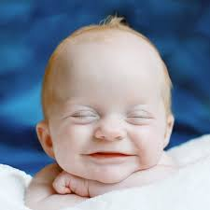
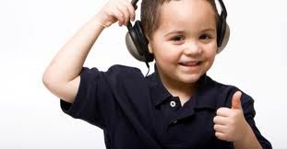

Division of Individual Learning
Outreach for Deaf/HOH

Slide 2
Janine Cole
Teacher of the Deaf/HOH
Outreach Supervisor
Welcome/Introduction

Slide 3
Outreach for Deaf and Hard of Hearing
Janine Cole, Supervisor-Cheyenne
Christie Fritz, Educational Consultant-Sheridan
Billie Wortham, Educational Consultant- Riverton
Jo Otterholt, Admin/Resource Library-Casper
Barb Norris, Contract Consultant-Cheyenne

Slide 4
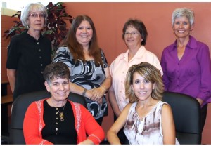
You can find out more about our outreach services on the WINWEB

Slide 5
Objectives for today:
Learn:
1. Anatomy and physiology of the ear
2. That not all hearing loss is the same
3. About hearing loss in the classroom setting
4. About child find and eligibility for hearing loss

Slide 6

Ask Questions…Jump In!

Slide 7
Billie Wortham
Audiologist
Outreach Consultant
Hearing and the Brain
Anatomy and Physiology

Slide 8
First Order Event
Hearing is a first order event for spoken language, reading and learning-all based on early development of the auditory centers in the brain.
Auditory cortex is the neural center of hearing, language and music.
The ability of the auditory cortex to process information necessary for speech and language is secondary to consistent stimulation.
Critical period birth-3 y.o., when brain plasticity is greatest.

Slide 9
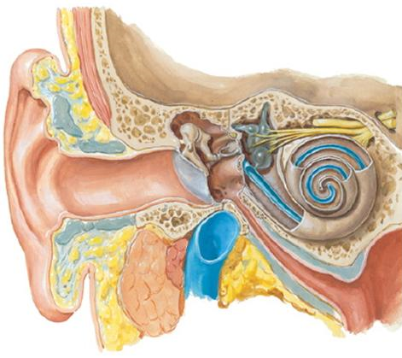


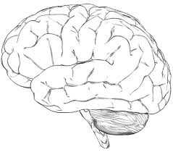

Slide 10
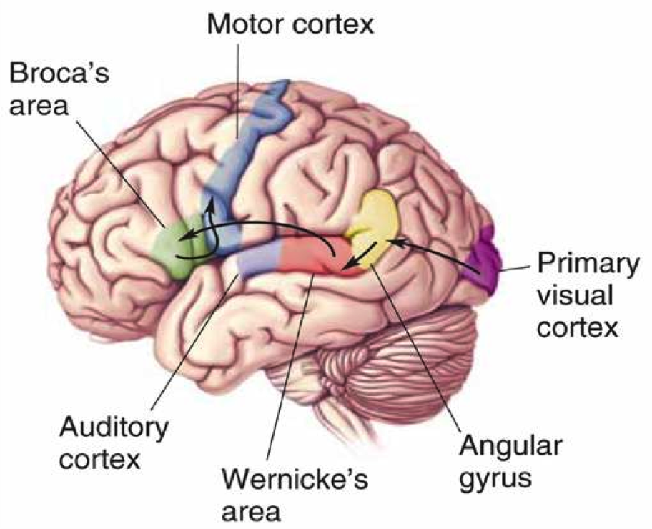
Receptive and Expressive Areas

Slide 11
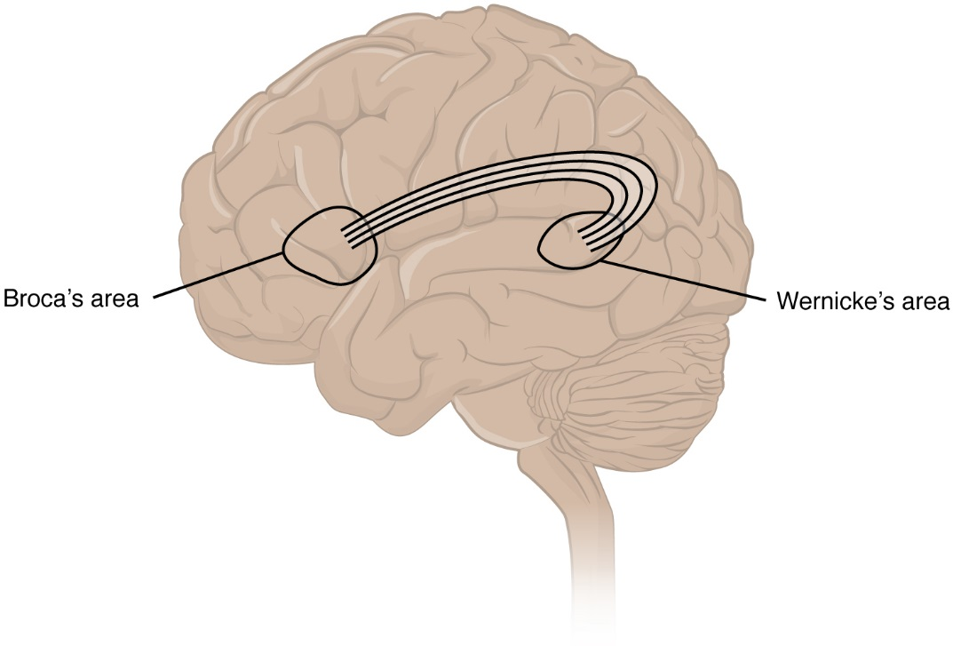
Neural Loop for Receptive/Expressive

Slide 12
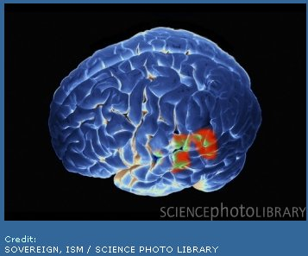

Brain-Hearing
Brain- Reading

Slide 13
Start at the Start
Type of HL
Location of HL-unilateral vs. bilateral
Duration of HL-if it was middle ear
When was it identified-i.e. birth, acquired
Age of intervention-time span from identification to intervention
Consistency of auditory signal i.e. did they wear their CI or HA’s

Slide 14
Anatomy/Physiology,
&
Types of Peripheral Hearing Loss

Slide 15
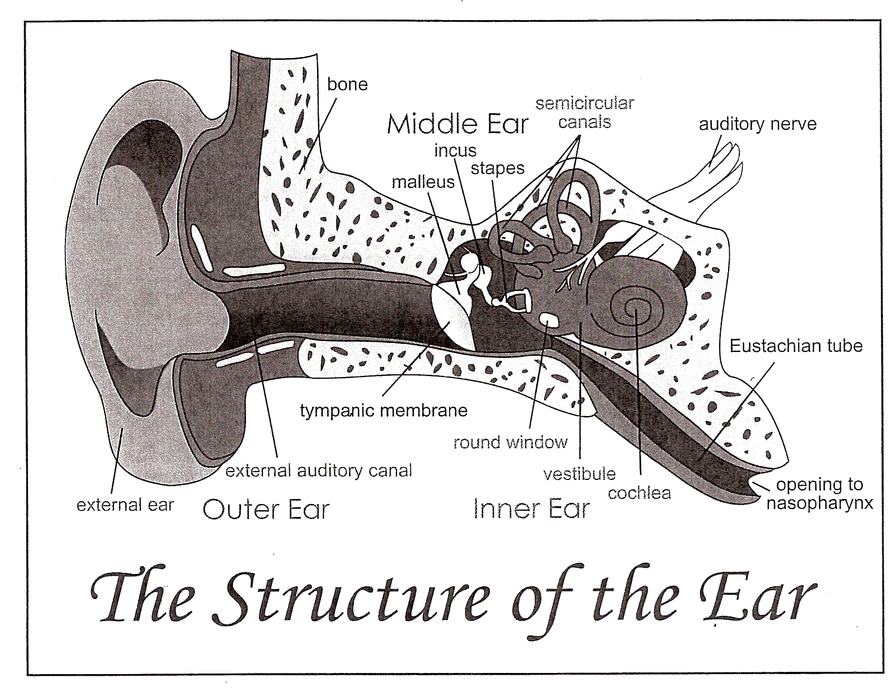

Slide 18
Types Of Peripheral Hearing Loss
Conductive
Sensorineural
Mixed

Slide 19
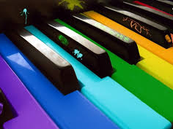
Tonotopic Organization

Slide 20
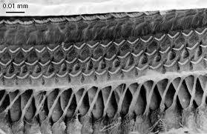
Hair Cells of the Cochlea

Slide 21
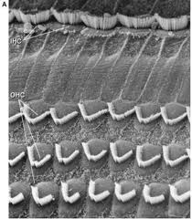
Hair cells determine clarity of sound

Slide 22
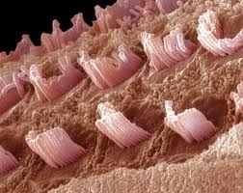
Damaged Hair Cells

Slide 23
Middle Ear Disease
5 million school days are missed each year due to otitis media
Fluid that arises takes an average of 40 days to be absorbed or drain
If a child has chronic OM (4-5 episodes over a 6-12 month period) s/he could experience a possible 200 days of reduced hearing in a year—a huge impact on “data entry”

Slide 24
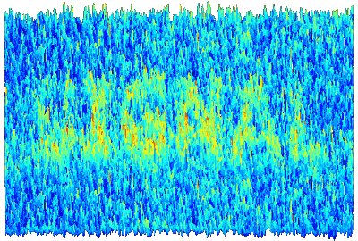
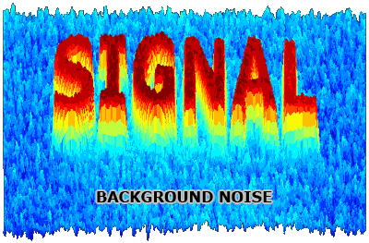

Slide 25
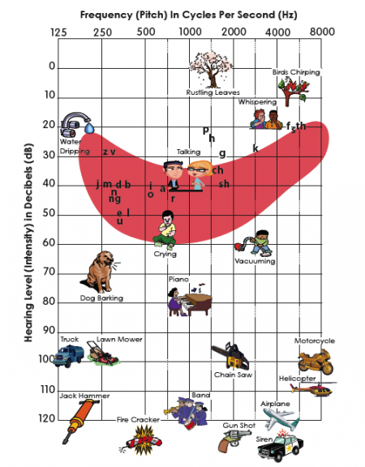
Familiar Sounds Audiogram
Frequency; Pitch; Hertz (Hz)
  Low frequency-vowels
  High frequency-consonants
  ‘Power’ vs. understanding
  500-4000 Hz most critical for understanding speech

Slide 26
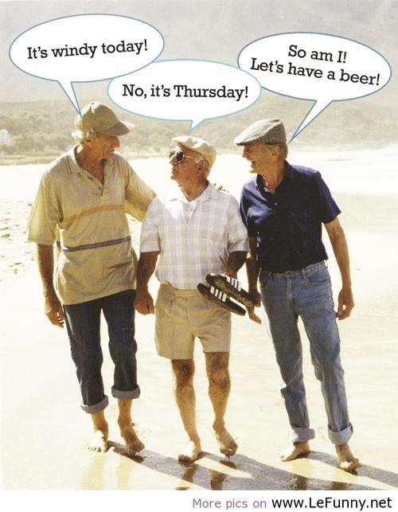
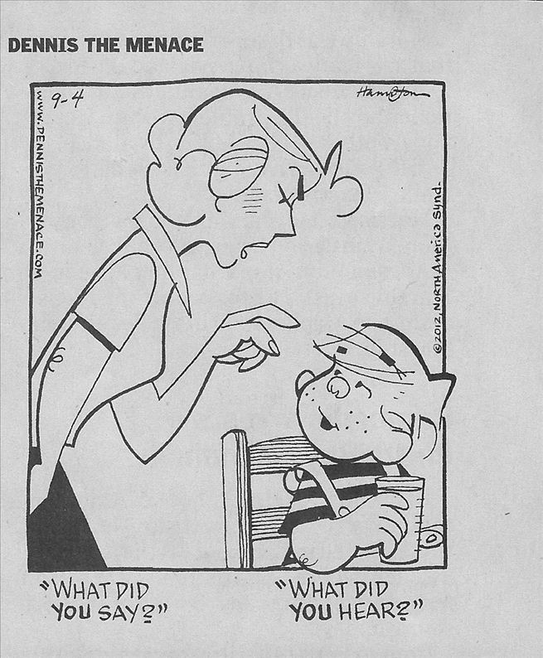

Slide 27

Questions?
WINWEB
Resources

Slide 28
Christie Fritz
Teacher of the Deaf/Hard of Hearing
Outreach Consultant
Hearing Loss In the Classroom

Slide 29
AN EXAMPLE OF THE ABILITY OF THE BRAIN TO
HEAR SPEECH WITH A HEARING LOSS
NORMAL HEARING: Freddie thought he should find a whistle.
MILD HEARING LOSS Freddie though- -e --ould -ind a whi—e.
MODERATE HEARING LOSS: -reddie --ough- -e --ould -i-- a --i—le.
SEVERE HEARING LOSS --e—ie --ou--- -e --ou-- -i-- a --i—le.
PROFOUND HEARING LOSS LOUDsoft LOUD soft soft LOUD soft…….
Notes:
I know we have this slide but this is nice cuz it is animated.

Slide 30
Spelling Test
“Number your paper from 1 to 10.”
1.
6.
2.
7.
3.
8.
4.
9.
5.
10.
Notes:
30

Slide 31

Spelling Words through Simulated
Hearing Loss above 1000 Hz
1.
125
250
500
1000
2000
4000
8000
2.
0
3.
10
20
z
v
4.
p
30
h
g
j
mdb
ch
5.
40
n
l
sh
ng
o
a
r
HEARING LEVEL (dB HL)
e i
50
u
6.
60
70
7.
80
8.
90
100
9.
110
120
10.
AUDIOGRAM OF FAMILIAR SOUNDS
FREQUENCY IN CYCLES PER SECOND (HZ)
Click on Speaker to
Present Spelling word.
Notes:
31

Slide 32
125
250
500
1000
2000
4000
8000
1.
Shoe
0
2.
Tree
10
20
z
v
f th
3.
Math
p
s
30
h
g
4.
Desk
ch
40
j
mdb
l
sh
n
o
a
ng
r
5.
Snack
50
e i
HEARING LEVEL (dB HL)
u
60
6.
Miss
70
7.
Test
80
8.
Thumb
90
9.
100
Fish
110
10.
Spill
120
AUDIOGRAM OF FAMILIAR SOUNDS
Click on Speaker to
Present Spelling word.
FREQUENCY IN CYCLES PER SECOND (HZ)
Notes:
32
Be sure and hide this slide on the handouts.

Slide 33
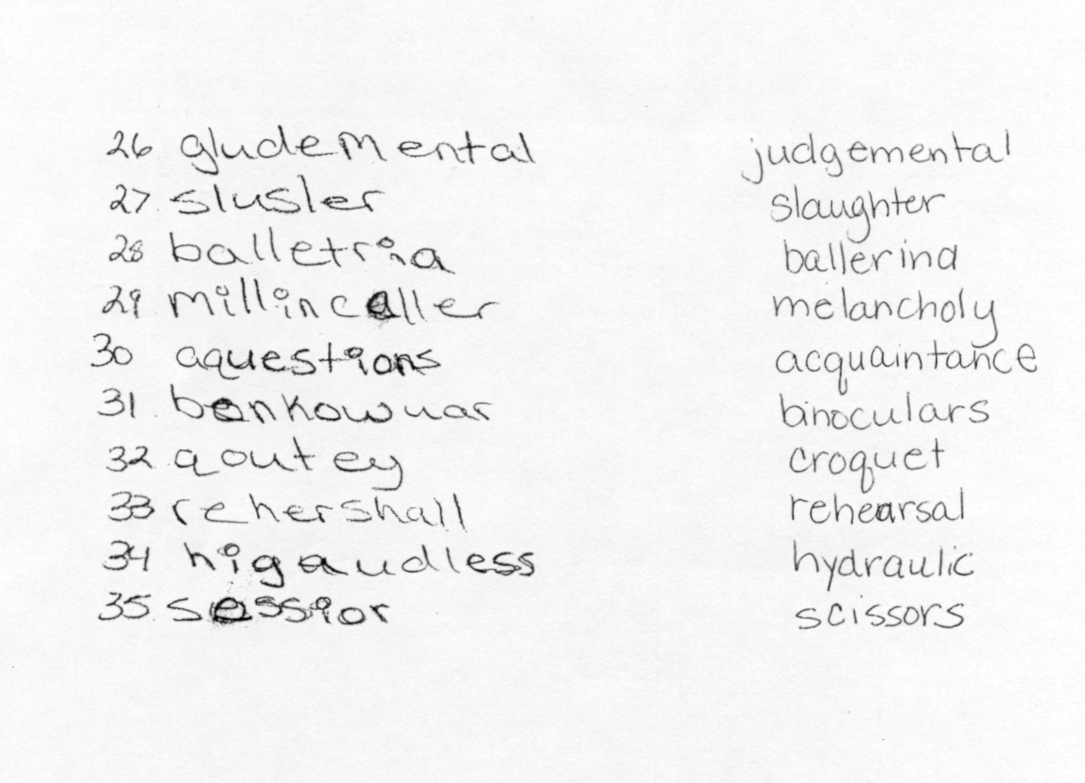
Actual Spelling Test of Hard of Hearing Student
Notes:
Explained by Sue…Spelltacular test given at the middle school. In addition, teacher was using amplification while administering the test. These are words that the student had never heard before so you can imagine now presenting new material in your classes. If a student doesn’t have a visual to take the new words off of then they may completely misinterpret what the words actually are and as a result do poorly on tests.

Slide 34
Let’s Talk
Lipreading…
cards

Slide 35

Just because someone HEARD you….
It doesn’t mean that someone
UNDERSTOOD

Slide 36
Deficits in Auditory, Speech & Language Skills
Writing
Listening
Reading
Talking
Communication

Slide 37
Assistive Listening Devices You Might See
In the Classroom

Slide 38
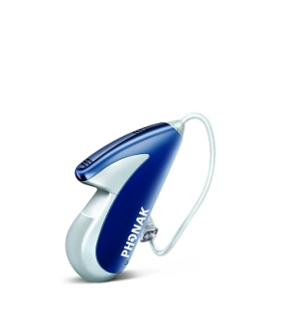
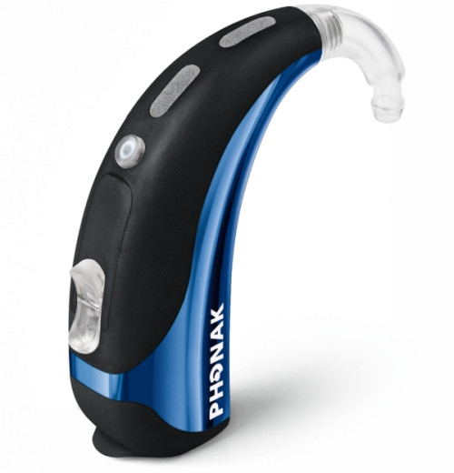
Hearing Aids

Slide 39
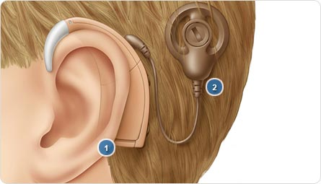
Diagram of a Cochlear Implant

Slide 40
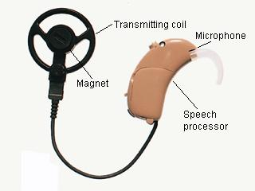
External Piece

Slide 41
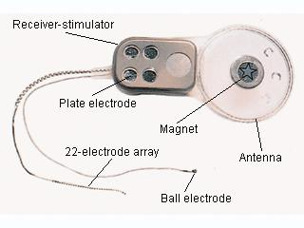
Internal Piece

Slide 42
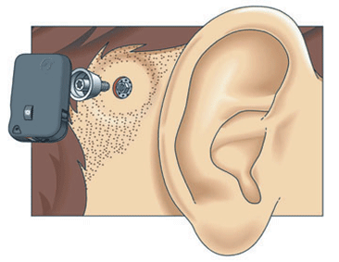
BAHA

Slide 43
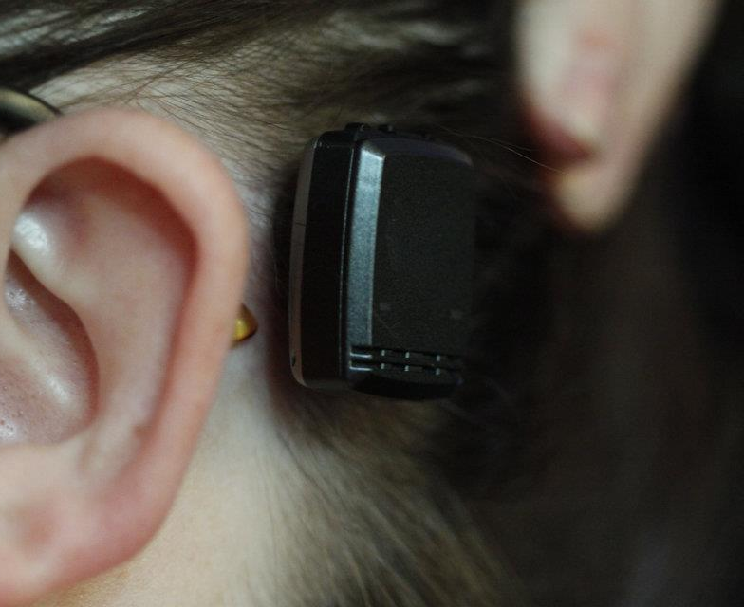
BAHA

Slide 44
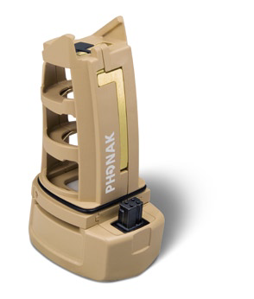
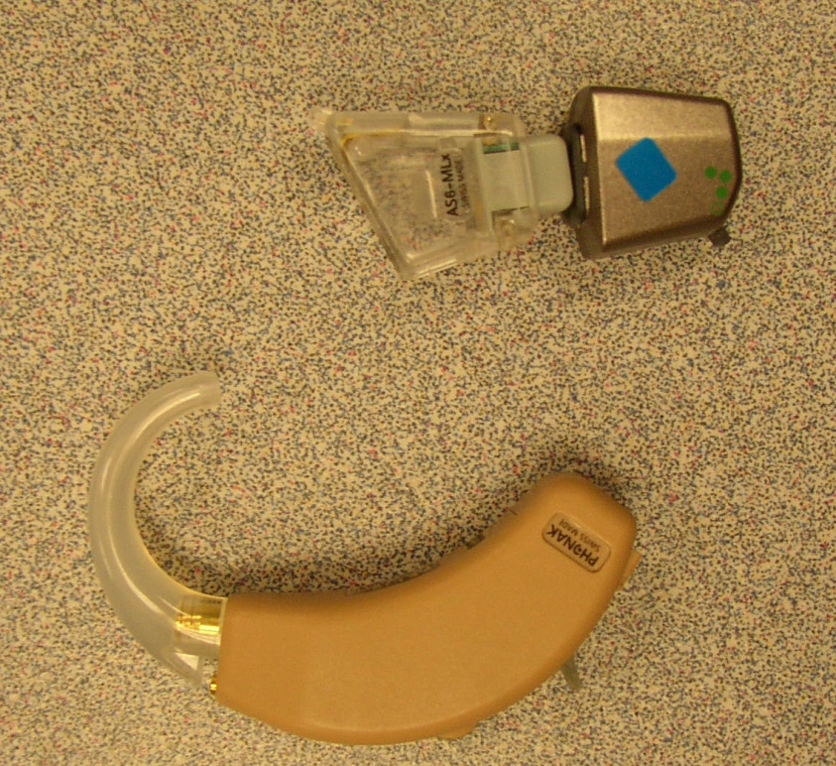

Personal FM Systems
MLxS FM RECIEVER
AUDIOSHOE
HA

Slide 45
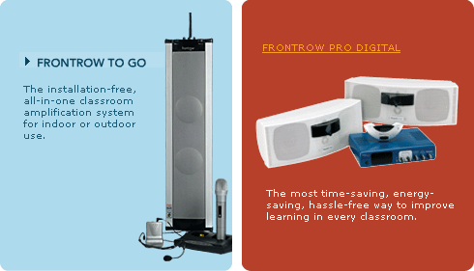
Classroom Sound Systems

Slide 46

Assistive Listening Devices help…but
They do not CURE
hearing loss or make
hearing NORMAL

Slide 47
Hurdles Still Exist
- Distance
- Background Noise
- Non-functioning device
- Irregular audiological visits

Slide 48
Just because someone HEARD you….
It doesn’t mean that someone
UNDERSTOOD

Slide 49
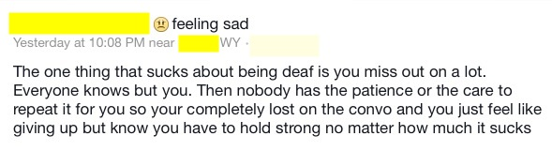
Reality Check

Slide 50
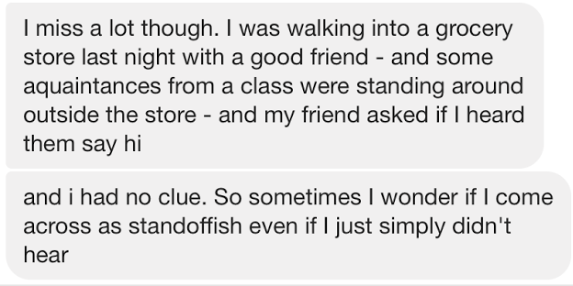
Reality Check

Slide 51
Classroom Strategies/Ideas
(handout)

Slide 52
Questions?
WINWEB
Resources

Slide 53
Barb Norris
Audiologist
Child Find and Eligibility

Slide 54
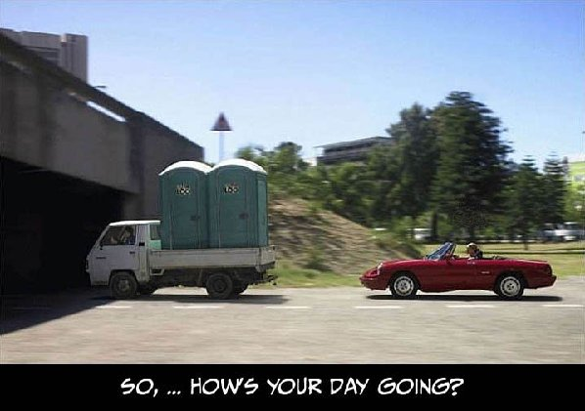

Slide 55
Eligibility Considerations for
Deaf/Hard of Hearing Students

Slide 56
Two Prong Test for Eligibility
Is there a disability?
Is specialized instruction needed?

Slide 57
WY INITIAL ELIGIBILITY CRITERIA FOR HEARING IMPAIRMENT
Documentation of the child’s potential requirement for amplification and one of the following hearing losses
  Sensorineural hearing loss, or
  Conductive hearing loss
  AND
Documentation that the hearing loss interferes with the student’s ability to function in an educational program using traditional materials and techniques due to the child’s delay in the use or understanding of spoken language.

Slide 58
Is the hearing loss ‘enough’?
Is the student ‘that far behind’?
Are the student’s difficulties the result of the hearing loss?

Slide 59
Is the Hearing Loss ‘enough’?
Nowhere in IDEA is the word enough defined; the E in IDEA does not stand for ‘enough’
Less than 5% of our students are Deaf (audiologically)
Consider accessibility; what we know about the impact of noise and distance

Slide 60

What is the Inverse Square Law?
For each doubling of distance
the signal is reduced by 6 dB

Slide 61
The distance problem
60 dBA
48 dBA
54 dBA
42 dBA
32 ft.
16 ft.
8 ft.
4 ft.
A typical teacher’s voice measures
60-65dB at a distance of four feet –
only enough for the front row to hear clearly!

Slide 62
Signal-to-Noise Ratio (S/N)
+10S/N
Speech at 50 dB
Noise at 40 dB
0 S/N
Speech at 50 dB
Noise at 50 dB
-10 S/N
Speech at 50 dB
Noise at 60 dB

Slide 63
Signal-to-Noise Ratio (S/N)
A child with hearing loss requires an optimum S/N of +12 to +15
The background noise in an occupied classroom is often 50-60 dB
If a teacher’s voice is at 50-60 dB
students are listening in a
0 S/N environment

Slide 64
Effects of Noise and Distance
A classroom with 50dB of background noise
Word recognition
100
90%
75%
80
40%
10%
60
typical classroom noise
40
20
0
10
20
30
40
distance from the teacher in feet

Slide 65
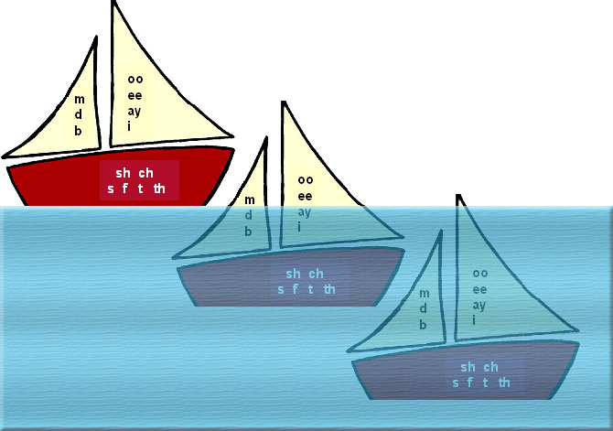
Impact of Noise on Speech Intelligibility
+15 dB S/N
Speech sounds fully audible
+6 dB S/N
Louder vowels and parts of consonants audible
Typical loudness of background noise in classrooms
is 60 dB when little attention to room acoustics is given)
0 dB S/N Noise competes with hearing all speech, especially quieter consonants
NOISE
Notes:
Mention book

Slide 66

What are the characteristics of low and
high tones?
60 dBA
4 feet
60
low tones
contain speech
power
high tones
contain speech
information
50
40
30
125
250
500
1000
2000
4000
8000
frequency in hertz
Notes:
While low tones carry speech energy and volume, they contribute little to the intelligibility. I’ll demonstrate.” [play low frequency clip; audience will probably have trouble understanding what was said]

Slide 67
Is the Hearing Loss ‘enough’?
Importance of the functional piece
  Relating the hearing loss to what goes on in the classroom
    Info from audiologist
    Assessments like LIFE-R (teacher and student)
Notes:
Last part

Slide 68
Is the Hearing Loss ‘enough’?
Importance of the functional piece (cont.)
  Assessments must be in the form most likely to yield accurate information on what the child knows and can do academically, developmentally and functionally. §300.304(c)(1)(iii)
    Because D/HH students have access issues, considering results that reflect function in quiet only will not accurately yield info about what the child can do functionally.
No single tool (e.g., audiogram) can be used as the sole criterion to determine eligibility §300.304(b)(2).

Slide 69
Is the Student ‘that far behind’?
OSEP (2007): educational performance doesn’t equal academic performance
A variety of assessment tools must be used to gather relevant functional, developmental, and academic information - including info provided by the parent. §300.304(b)(1)
  Too often information from the parent regarding the child's functional performance is not solicited or valued in eligibility determination (e.g., CHILD or Starting School LIFE checklists for younger children).
The child is assessed in all areas related to the suspected disability, including, if appropriate, health, vision, hearing, social and emotional status, general intelligence, academic performance, communicative status, and motor abilities §300.304(c)(4).

Slide 70
Is the Student ‘that far behind’?
Assessment tools and strategies must be selected that provide relevant information that directly assists persons in determining the educational needs of the child. §300.304(c)(7).
  A certain amount of delay is not required; delay in a certain area is not required. Specifically, ANY difference in social, emotional, language, speech, auditory skills, etc. is sufficient for eligibility. Not just total standard scores count; performance on subtests or age-anchored assessments also would suffice for evidence of educational need.

Slide 71
Is the Student ‘that far behind’?
Evaluators must use technically sound instruments that may assess the relative contribution of cognitive and behavioral factors, in addition to physical or developmental factors. §300.304(b)(3).
  Application of a rule such as "only children with scores outside of -1.5SD will be found eligible" does not take into account the results of functional measures (not usually norm-referenced) that are age-anchored (criterion referenced) or identify issues related to reduced access secondary to hearing loss.

Slide 72
Are the student’s difficulties the result of the hearing loss?
Educational needs are broader and not equivalent to academic needs. Because hearing loss causes access barriers, planning for children with hearing loss must always include consideration of both educational needs (IDEA) and communication effectiveness that is equal to non-hearing-impaired peers (ADA)
In evaluating each child with a disability the evaluation must be sufficiently comprehensive to identify all of the child’s special education and related services needs, whether or not commonly linked to the disability category in which the child has been classified. §300.304(C)(6)

Slide 73
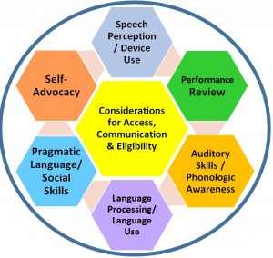
Assessments for D/HH Students

Slide 74
2nd Prong: Need for Specialized Instruction
“What skills does the student need to learn to be able to fully participate and make progress in the general education curriculum?”

Slide 75
Example of an Impact Statement Relating Hearing Loss to Classroom Performance
STUDENTS's hearing loss inhibits HIS/HER progress in the general curriculum by impeding HIS/HER access to speech and language through audition in the same manner as HIS/HER normal hearing peers. HIS/HER speech discrimination ability is reduced when seated at a distance greater than 6 feet from the speaker, in a noisy or reverberant environment, and when the speaker is not within HIS/HER line of vision. HE/SHE is also unable to access incidental learning the same as HIS/HER normal hearing peers. Therefore student requires direct instruction in a controlled listening environment to address areas of weakness in.... (language, audition, self advocacy skills, speech perception, social skills, ETC).... (may also name specific areas of academic weakness).

Slide 76
Final Thoughts…
IEP/Assessment teams have lots of latitude
Give appropriate consideration to a child’s access to instruction
  The best goals and objectives become meaningless if the child doesn’t have access
Look ahead and ask, “If this child is not identified and served, where will they be in a year? Two years?

Slide 77
Questions?
WINWEB
Resources

Slide 78
THANK YOU !

