Slide 1
Screeners in a Multi-Tiered System of Support
College Career Readiness and Success Center
Jenny Scala
Senior Researcher, American Institutes for Research
December 2016

Slide 2
Introductions
Using participant list as master list
Please share:
Your name
Work role and location
Favorite aspect of winter holidays

Slide 3
Screeners in a Multi-Tiered System of Support
College Career Readiness and Success Center
Jenny Scala
Senior Researcher, American Institutes for Research
December 2016

Slide 4
Session Overview
Agenda:
Review of multi-tiered systems of support (MTSS)
Discuss screeners in MTSS
Explore early warning systems in MTSS context

Slide 5
Overview of MTSS

Slide 6
What is MTSS?
Prevention framework that
Organizes building-level resources to address individual students’ academic or behavioral needs
Integrates assessment and a continuum of instruction and interventions
Incorporates multiple intervention tiers that vary in intensity
Provides timely intervention for students who are at risk for poor learning outcomes or may need enrichment opportunities
Response to intervention (RTI) and positive behavioral interventions and supports (PBIS) are examples of MTSS.

Slide 7
Center for Response to Intervention

Slide 8
Key Components of MTSS
Research-driven practices (academic, behavioral, attendance)
Screening
Progress monitoring
Interventions that increase in intensity across a continuum of tiers
Data used to inform decisions across the continuum of the framework

Slide 9
Screeners

Slide 10
Screening
Identify students at risk for poor outcomes (e.g., learning, behavioral, graduation)
Identify students who need additional assessment (i.e., progress monitoring) and instruction or support (i.e., targeted or intensive)
Provide data on the effectiveness of the core instruction, curriculum, and schoolwide supports
Should be valid and reliable
Notes:
The first component, screening aims to: Review slide
Traditionally in high schools we have lacked valid and reliable ways of identifying which students are at risk– that’s one reason that HS use MTSS broadly to support dropout prevention/grad rates.

Slide 11
Early Treatment of Diabetic Retinopathy Study (ETDRS) Chart
http://www.visionaware.org/info/your-eye-condition/eye-health/low-vision/low-vision-examination/1235

Slide 12
Overview of Early Warning Systems and Early Warning Indicators

Slide 13
A Definition
An early warning system (EWS) relies on readily available data housed at the school to accomplish the following:
Predict which students are at risk of missing key education milestones
Target resources to support off-track students early
Examine patterns and identify school issues

Slide 14
Implementation Pathway of EWS
Synthesize Research
Validate Indicators
Customize and Develop Tools and Supports
Launch and Implement Early Warning Intervention Monitoring System
Assess and Improve Processes

Slide 15
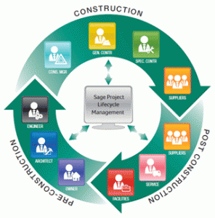
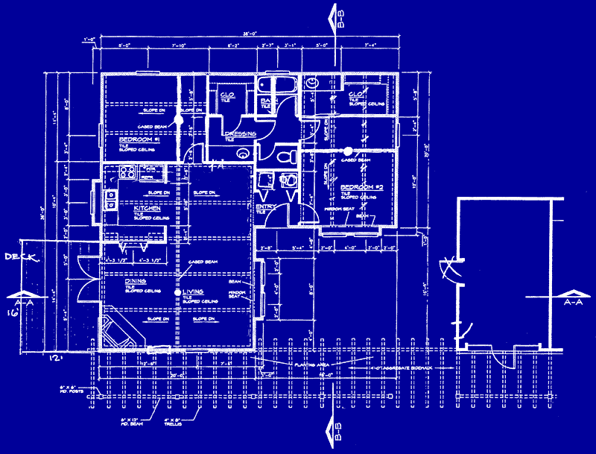
Components of an EWS
Early warning indicators
Implementation process
https://www.pinterest.com/aab378/blueprints/
http://www.planningengineer.net/construction-project-management-essential-4-terms-you-should-know/

Slide 16
Early Warning Indicators
Early warning indicator identify students at risk of dropping out of high school:
Typically includes attendance and academic indicators
Indicators should be validated for local context
Reviewed at multiple times during the school year
Behavior doesn’t have the research nationally to confidently support using as an indicator
Notes:
In thinking about screening within the context of dropout prevention we can use an EWS as a screener with the focus on identifying whether a student is at risk of dropping out of high school. Research from the Consortium on Chicago School Research http://ccsr.uchicago.edu/publications/on-track-graduation and Everyone Graduates Center at Johns Hopkins http://www.every1graduates.org/ have identified key risk indicators at the middle and high school levels. These indicators or locally validated indicators typically focus on attendance, behavior, and academic indicators. These data are reviewed across multiple points of time within the year to monitor students and identify those that might be at risk.

Slide 17
Early Warning Indicators for High School Graduation
Indicator | Middle School | High School
Attendance | Missing 20% or more | Missing 10% or more
Grade Point Average | Not applicable | 2.0 or lower on 4.0 scale
Course Performance | Failing ELA or math | Failing any course
Chicago On Track | Not applicable | Credit deficient for promotion to 10th grade AND one or more failures in core courses

Slide 18
Citations for EWI Thresholds
Allensworth, E. M., & Easton, J. Q. (2005). The on-track indicator as a predicator of high school graduation. Chicago, IL: University of Chicago Consortium on Chicago School Research. Retrieved from https://consortium.uchicago.edu/sites/default/files/publications/p78.pdf
Allensworth, E. M., & Easton, J. Q. (2007). What matters for staying on-track and graduating in Chicago public high schools: A close look at course grades, failures, and attendance in the freshman year. Chicago, IL: University of Chicago Consortium on Chicago School Research. Retrieved from http://ccsr.uchicago.edu/sites/default/files/publications/07%20What%20Matters%20Final.pdf
Balfanz, R., Herzog, L., & Mac Iver, D. J. (2007). Preventing student disengagement and keeping students on the graduation path in urban middle-grades schools: Early identification and effective interventions. Educational Psychologist, 42(4), 223–235.
Bowers, A. J., Sprott, R., & Taff, S. A. (2013). Do we know who will drop out? A review of the predictors of dropping out of high school: precision, sensitivity, and specificity. The High School Journal, 96(2), 77–100.
Heppen, J. B., & Therriault, S. B. (2008). Developing early warning systems to identify potential high school dropouts. Washington, DC: National High School Center. Retrieved from http://files.eric.ed.gov/ fulltext/ED521558.pdf

Slide 19
Jenny Scala
jscala@air.org
1000 Thomas Jefferson Street NW
Washington, DC 20007
800-634-0503
www.ccrscenter.org | ccrscenter@air.org

