Slide 1
ANY QUESTIONS FROM LAST SESSION ON TIER 1 PRACTICES/IMPLEMENTATION?
Welcome Back

Slide 2
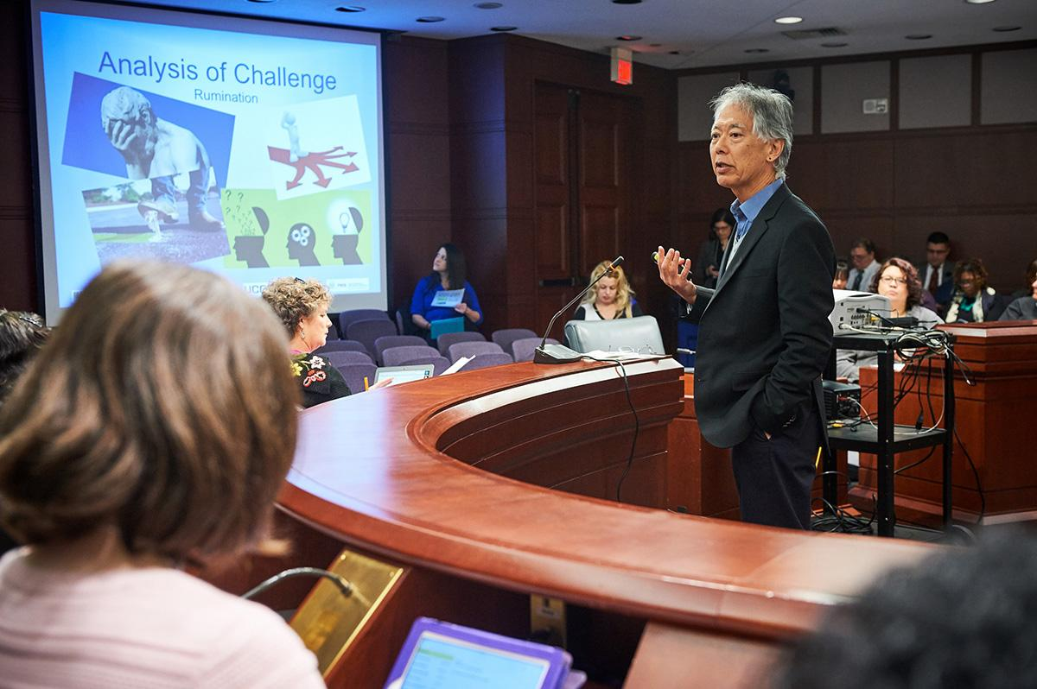
Information provided is credited to www.pbis.org and www.nepbs.org
with support from Dr. George Sugai

Slide 3
In an effort to avoid confusion; MTSS-B and PBIS will be used interchangeably.

Slide 4
MTSS has become the over-arching framework or umbrella for tiered system approaches.
Notes:
MTSS has evolved out of the early work done with special education and Response to Intervention in the 90’s. OSEP said that schools needs to provide students with learning difficulties intervention choices before and after identification for special education.
MTSS in the framework for applying this logic to general education and will be referenced in ESSA.

Slide 5
Getting Started with SWPBIS
Tier 1 Review of components
Establish an effective leadership team
Develop brief statement of behavioral purpose
Identify positive SW behavioral expectations
Develop procedures for teaching SW expectations
Develop procedures for teaching class-wide expectations
Develop continuum for strengthening appropriate behavior
Develop continuum for discouraging violations of expectations
Develop data-based procedures for monitoring
Develop systems to support staff
Build routines to ensure on-going implementation
www.nepbs.org with support from Dr. George Sugai

Slide 6
Tier 2 Readiness Checklist www.nepbs.org Tier 1 School-wide tab
“Although the implementation of advanced tiers is likely to be more effective and efficient if Tier 1 is implemented with sustainable high fidelity prior to implementing Tier 2, schools may need to provide Tier 2 supports to meet student needs prior to full Tier 1 implementation. “

Slide 7
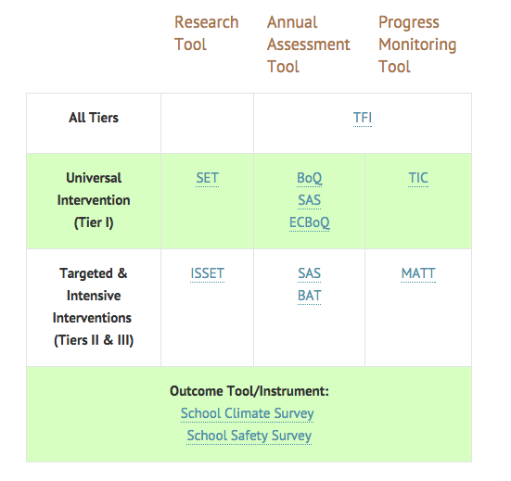
Suggested Data Sources
www.pbis.org
Notes:
School-wide Evaluation Tool (SET)- When school teams want an outside evaluation of Universal (Tier 1) SWPBIS implementation, the SET is recommended.
Tiered Fidelity Inventory (TFI) is based on earlier PBIS fidelity surveys (SET, BoQ, TIC,BAT, etc). The TFI gives teams a single, efficient, valid, reliable survey to guide implementation and sustained use of SWPBIS. This is designed for school system planning teams.

Slide 8
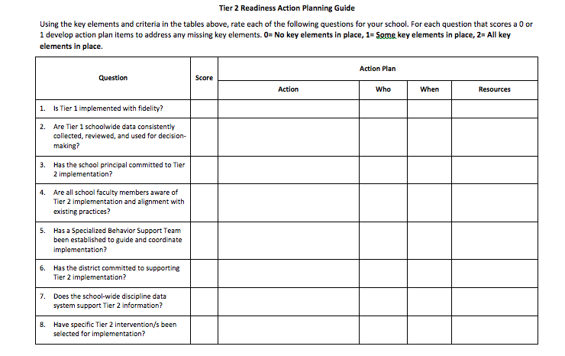

Slide 9
Behavior Interventions
Meaningful Work
Check and Connect
Checkin/Checkout
Mentoring
Social Skills Groups
Notes:
It may be a good idea to have just a couple of interventions at the tier 2 level.

Slide 10
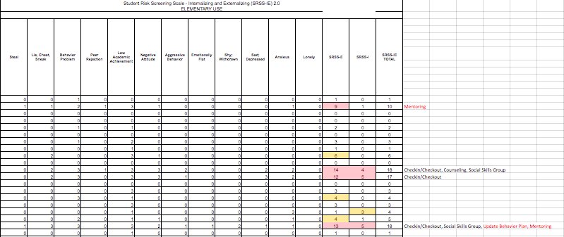
Process for Selecting Students for Tier 2 Interventions

Slide 11
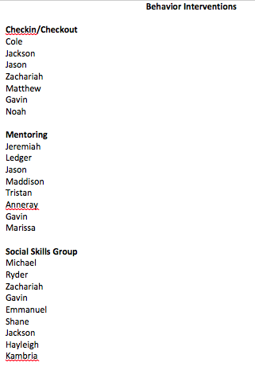
Process for Selecting Students for Tier 2 Interventions
Notes:
Ultimately the screening data determine who needs intervention but it is up to the teacher and parent along with the intervention team to choose the best fit.

Slide 12
Meaningful Work

Slide 13
“Meaningful Work is a school-based jobs program that gives students responsibility and so help them develop purpose, self-worth, and a sense of belonging. This positive behavior support can help students with a history of misbehavior and school failure become contributing members of their schools.”

Slide 14
Starting Out
Identify the student (start small with
1 or 2 high-needs students).
Review data and set goals.
Match the student to a job.
Collect data to monitor progress.
Consider designing a system for rewards and consequences.
Identify a supervisor.
Introduce the job.
Provide job training.
Maintain success on the job. Review data and modify plans as needed.
Celebrate accomplishments large and small.

Slide 15
The Jobs
Assembly Equipment Specialists
Banner Maker
Birthday Manager
Bus Cone Manager
Card artist
Coffee cup collector
Computer starter
Copier Technician
Display case manager
Greeter of new students
Librarian’s Assistant
Lost and Found Manager
Lunch server
Popcorn Crew member
About 75 Job Examples listed by grade level.

Slide 16
Check and Connect
www.checkandconnect.umn.edu

Slide 17
Check and Connect Summary
Check & Connect is implemented by a trained mentor whose primary goal is to keep education a salient issue for disengaged students and their teachers and family members. The mentor works with a caseload of students and families over time and follows their caseload from program to program and school to school.

Slide 18
Check in/Check out
One staff person conducts this intervention
The staff person and the student’s teacher create a daily tracker with a goal
The staff person meets with each student at the beginning of the day to go over their tracker and goal
Throughout the day the teacher(s) rates the student
At the end of the day the staff person meets with the student to see if they made their goal

Slide 19
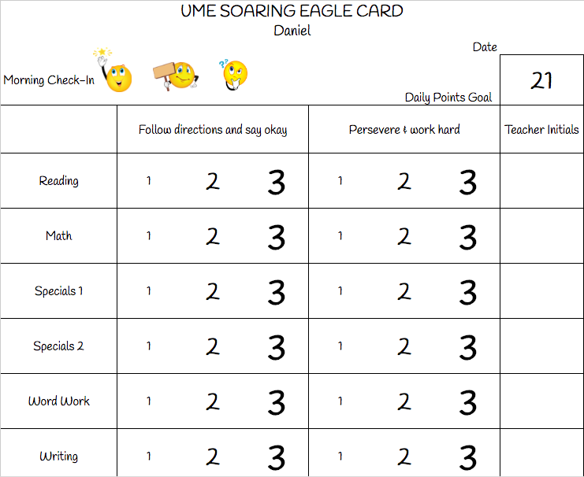
Check in/Check out Tracker

Slide 20
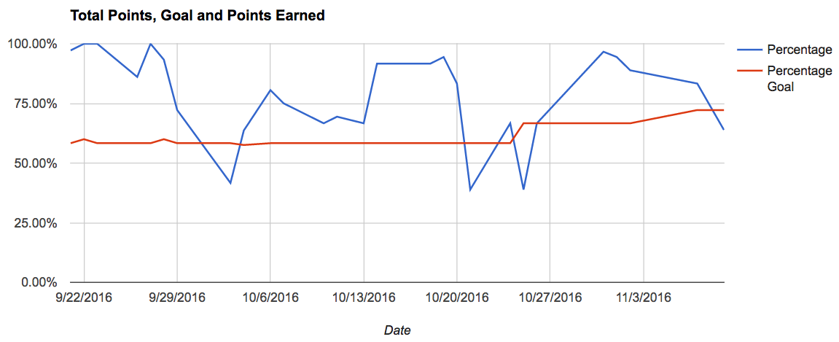
Progress Monitoring Checkin/Checkout
Notes:
A good rule of thumb with setting goal line is to start at 50% of their points.

Slide 21
Mentoring
At risk student meets with an adult one time per week for an enjoyable activity
Purpose is to develop a positive relationship with an adult
Mentor asks the student how things are going and listens to student
There is no task demand during this time
Notes:
Mentoring is the easiest to implement but one the most difficult to make sure is done well. One of the areas that this intervention gets messed up is when the mentor is checking in on tasks and grades and such. This is not contingent on good behavior.

Slide 22
Other Versions of Mentoring
H.U.G. Hello Update Goodbye (Hallvik, Helton, Ferguson 2000)
pbis.org
Connections. Safe and Civil Schools; Dr. Mickey Garrison
This is a web-based behavioral intervention program that combines elements of check-in/check out and mentoring.
School-based mentoring

Slide 23
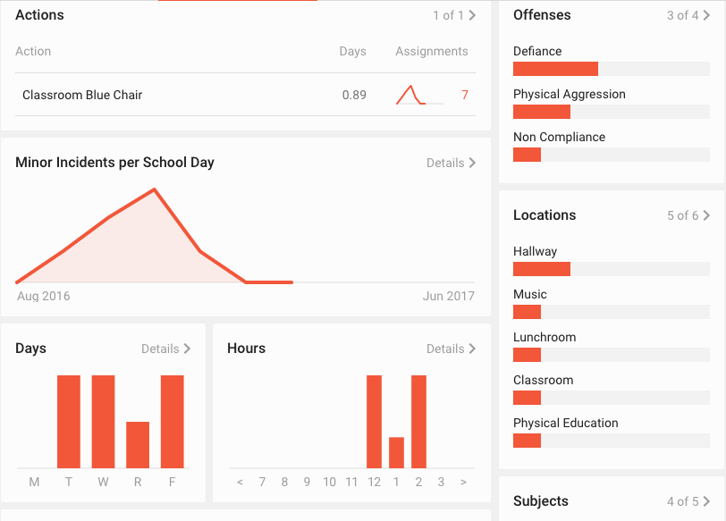
Progress Monitoring for Mentoring

Slide 24
Social Skills Groups
Students are placed in social skills groups based on screening data and teacher/parent recommendation
There are many writing social skills curriculum
Aggression Replacement Training
Tough Kids Social Skills
Second Step
Notes:
Typically conducted by a counselor. The programs should include modeling and practicing.

Slide 25
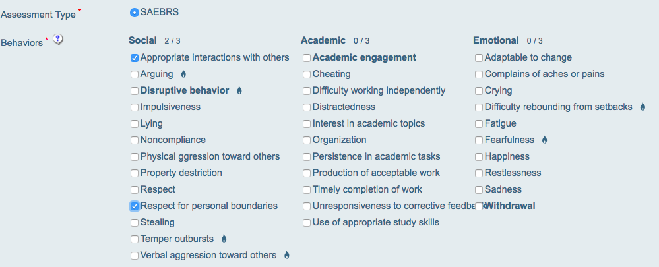
Progress Monitoring for Social Skills

Slide 26
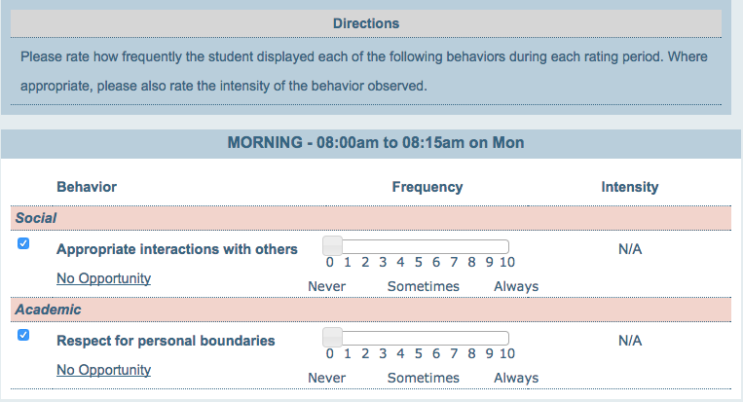
Direct Behavior Rating

Slide 27
DBR Data Collection

