Slide 1
Implementation of Multi-tiered Systems of Support (MTSS)
Module 1
Notes:
Welcome participants to the module on MTSS.
Throughout this module, the notes will be formatted in the following way:
Notes for the facilitator:
Text formatted in standard font is intended to be read aloud by the facilitator.
Text formatted in italics is intended as directions or notes for the facilitator; italicized text is not meant to be read aloud.
Please refer to the accompanying facilitator guide for additional information and resources.
Materials:
Module 1 Participants’ Workbook

Slide 2
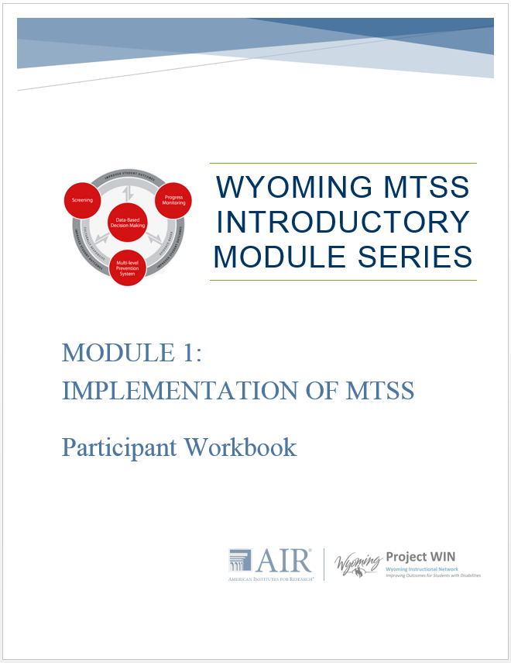
Welcome!
Introductions
Materials
Parking lot
Notes:
Introduction slides (slides 1–6) delivery time: 10 minutes
Please refer to the general facilitator guide for recommendations for participant introduction activities, recommended materials, and setting up a parking lot.

Slide 3
Introductory MTSS Module Series Overview
Implementation of Multi-Tiered Systems of Support
MTSS Essential Component: Universal Screening
MTSS Essential Component: Data-Based Decision Making
MTSS Essential Component: High-quality Tier I
MTSS Essential Component: Progress Monitoring
MTSS Essential Component: Evidence-based Tier II
MTSS Essential Component: Data-based Individualization for Tier III
Notes:
Across the country, local school districts, particularly those challenged by often long-standing achievement gaps and higher mandated standards for student performance, are increasingly turning to implementation of Multi-tiered Systems of Support (MTSS), also referred to as response to intervention, to align academics and behavior interventions, decision making, and supports. They are finding that MTSS provides an effective framework for turning around schools, reforming curricula to meet student learning needs better, and improving outcomes for all students, including those from culturally and linguistically diverse backgrounds.
The Wyoming Department of Education (WDE), in partnership with American Institutes for Research, developed this Introductory MTSS Professional Development series to support rollout of MTSS and the use of evidence-based practices. The WDE strongly believes implementation of MTSS can support districts in implementing several state initiatives, including the State’s plan for implementing Every Student Succeeds Act (ESSA), the State Systemic Improvement Plan for improving results for students with disabilities, and efforts to improve chronically failing schools and increase student achievement. The alignment of MTSS with these initiatives will be discussed in more detail later in this module.
Click for animation.
Today’s module, Implementation of Multi-tiered Systems of Support (MTSS), is the first of seven modules about MTSS. The remaining six modules will introduce you to the essential components of MTSS. The content presented today should in no way be viewed as exhaustive or legally binding. You should continue to seek and participate in ongoing professional development related to the topics presented today and in future sessions.
Additional Resource: Essential components of RTI—A closer look at response to intervention, National Center on Response to Intervention, 2010 [http://www.rti4success.org/sites/default/files/rtiessentialcomponents_042710.pdf]
Briefly review module series overview.

Slide 4
Session Outcomes
By the end of this session, participants will be able to:
Identify two benefits of schoolwide MTSS implementation
Identify the four essential components of MTSS implementation
Explain how MTSS aligns with and supports existing state and district initiatives
Establish an MTSS team to support schoolwide implementation
Notes:
Review slide.

Slide 5

Activator Activity
Handout 1.1
Notes:
Please locate Handout 1.1 in your participant workbook. Use the handout to jot down a few thoughts about what you think MTSS is in the first column. Consider what you may have heard about MTSS frameworks and how they are implemented.
Give participants several minutes to jot down some ideas.
Now, turn and talk with the person next to you about ideas that you generated. What differences and commonalities do you see?
Alternatively, you could have participants get up and talk with someone across the room, someone they have not met, and so on.
Clip art: Creative Commons ; retrieved from https://www.flickr.com/photos/wingedwolf/5471047557

Slide 6
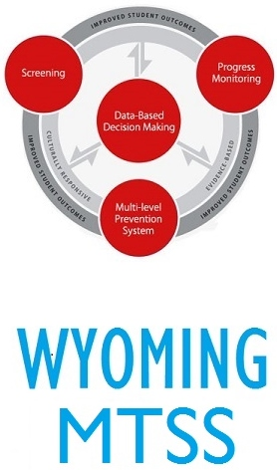
Notes:
Multi-tiered systems of support, or MTSS, in Wyoming is a preventative framework for school improvement made up of four essential components. The four components are screening, multilevel prevention system, progress monitoring, and data-based decision making. MTSS in Wyoming also encompasses features such as culturally responsive instruction, family engagement, and evidence-based instruction. As you’ll notice in the graphic, each of the components and features contribute to improved student outcomes. We’ll talk more about each of the components in upcoming modules.

Slide 7
Why MTSS?
Notes:
Section objective: Identify two benefits of schoolwide MTSS implementation
Key ideas:
Present evidence-based practices for schoolwide MTSS
Outcomes of effective implementation of MTSS
Present how MTSS supports multiple state and federal initiatives
Delivery time: 10 minutes

Slide 8

Why MTSS?
Sustained improvements in academic performance for ALL students
Decreased expulsion, behavioral referrals, and suspension rates
  (Source: Burns, Appleton, & Stehouwer, 2005; Dexter, Hughes, & Farmer, 2008; Simmons, Coyne, Kwok, McDonagh, Harn, & Kame’enui, 2008)
Notes:
Refer participants to the second column, first row of Handout 1.1 and ask them to record their learning. Read slide.
The information below can be shared with the group or used as a reference if participants have questions about this slide.
In a review of four RTI studies (research-based and large-scale implementation), Burns, Appleton, and Stehouwer (2005) found strong effects on student academic outcomes and system outcomes (referrals to and/or placements in special education, student time in special education services, and number of students retained in a grade) when RTI was implemented with fidelity.
Dexter, Hughes, and Farmer (2008) found improved academic performance and a slight decrease in special education referral and placement rates because of the implementation of RTI.
Simmons, Coyne, Kwok, McDonagh, Harn, and Kame’enui (2008) found that students who were identified early as at risk and were provided additional reading supports had improved performance that was sustained over time.
Institute of Education Sciences (IES) practice guides provide additional evidence and recommended instructional practices
Reading: http://ies.ed.gov/ncee/wwc/PracticeGuide/3
Math: http://ies.ed.gov/ncee/wwc/PracticeGuide/2

Slide 9
Why MTSS?
Strong positive effects on system outcomes
  Decreased inappropriate special education referral and placement rates
  Reduction in student time in special education services
  Reduction in student grade retention
  (Source: Burns, Appleton, & Stehouwer, 2005; Dexter, Hughes, & Farmer, 2008; Simmons, Coyne, Kwok, McDonagh, Harn, & Kame’enui, 2008)
Notes:
Read slide. See also previous slide speaker notes.
Clip art: Creative Commons

Slide 10
Outcomes of
Effective MTSS Implementation
Enhanced collaboration
Positive impact on student learning and achievement
Opportunities for early intervention
Reduction in behavior referrals
Notes:
In addition to sustained improvements in academic performance and decreased expulsion, behavioral referrals, and suspension rates, other outcomes of MTSS implementation include opportunities to intervene early and enhanced collaboration among school staff. These outcomes have a positive impact on student learning and achievement.

Slide 11
Video: MTSS Coach
Handout 1.1
Notes:
Following the video, pause for a reflection activity.
Turn and talk with the person next to you about a “wow” (something that was good and positive) and a “wonder” (question about MTSS) that was prompted from the video or other material presented in this section.
Give participants several minutes to discuss, and then call the group back together and ask if anyone is willing to share a wow or wonder.

Slide 12
What Is MTSS in Wyoming?
Notes:
Section objective: Identify the four essential components of MTSS implementation
Key ideas:
Overview of MTSS framework
Introduction to Wyoming MTSS Fidelity Rubric (based on Center on Response to Intervention)
Introduction to the four essential components
Delivery time: 20 minutes

Slide 13
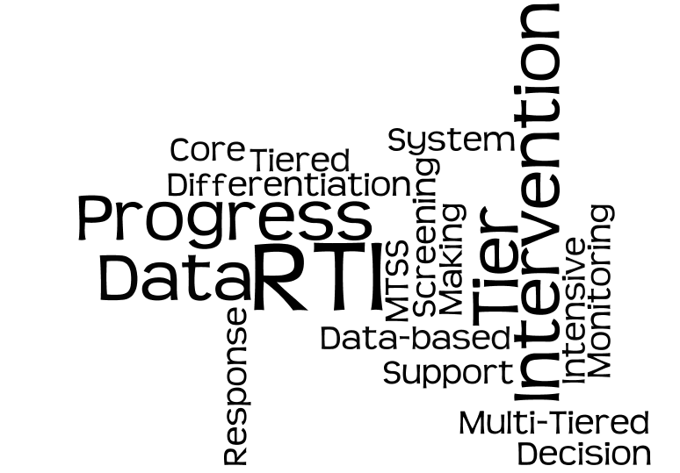
Notes:
Many terms and phrases are thrown around when discussing tiered frameworks. These may include:
Positive Behavioral Intervention and Supports (PBIS, SWPBIS, PBS)
Universal Design for Learning (UDL)
Response to Intervention (RTI, RtI)
Response to Instruction and Intervention (RtII)
Academic tiered system of supports
Behavioral tiered system of supports
Multi-tiered Systems of Support (MTSS)
You also may have heard about components such as data-based decision making, progress monitoring, intervention, differentiation, screening, tier, and prevention level. Regardless of what the framework is called, we are going to talk about some of the key features of a tiered system such as MTSS and the underlying purpose for a multilevel prevention system.

Slide 14
Defining MTSS
MTSS integrates assessment and intervention within a schoolwide, multilevel prevention system to maximize student achievement and reduce behavior problems.
(Adapted from National Center on Response to Intervention, 2010)
Notes:
Refer participants to the second column, second row of Handout 1.1 and ask them to record their learning.
Have participants read the definition and highlight (verbally) the important words or groups of words in the definition. Discuss.
Since 2007, the National Center on Response to Intervention (NCRTI)—a federal center funded by the Office of Special Education Programs, Department of Education—used the term RTI to represent the integrated, tiered academic and behavior model. WDE uses MTSS to represent the integrated behavior and academic prevention model, similar to many states. The term was selected because it represented a broader system of tiered supports, including those beyond academics (e.g., speech and language, medical screenings). The next slide shows how Wyoming views MTSS as the overarching framework for the various types of support systems available for students.

Slide 15
MTSS
Health (e.g., Weight, Height, Scoliosis)
Vision and Hearing
Behavior (PBIS)
Social-Emotional
Speech and Language
Academics
Notes:
The slide has animations.
Click for animation. MTSS supports students academically, primarily in math and reading. However, there are many, or the potential for many, different types of tiered supports within a school system.
Click for next animation. Many of you may be familiar with Positive Behavioral Intervention and Supports, or PBIS, which is a tiered system of support focused on providing increasingly intense behavior supports.
Click to show remaining animations. There are other types of tiered supports that may be part of your school. Review slide.
Optional discussion:
What types of tiered systems of supports are currently available in your school or district?
What other potential tiered systems are possible (e.g., family engagement supports)?

Slide 16
Understanding MTSS
With an MTSS prevention framework, schools
  Identify students at risk for poor learning outcomes
  Monitor student progress
  Provide evidence-based interventions
  Adjust the intensity and nature of those interventions on the basis of a student’s responsiveness
  May use it as part of the determination process for identifying students with specific learning disabilities
(Source: National Center on Response to Intervention, 2010)
Notes:
MTSS integrates assessment and intervention within a schoolwide, multilevel prevention system to maximize student achievement and reduce behavior problems.

Slide 17
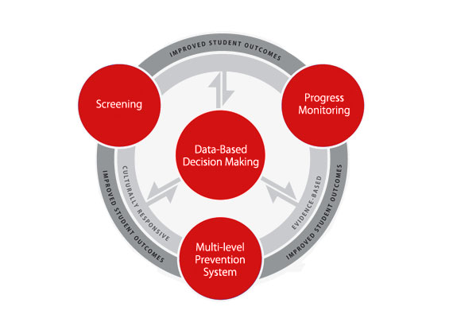
Essential Components of Wyoming MTSS
Notes:
This slide includes animation. Components of Wyoming MTSS will be highlighted with a mouse click in the order listed below.
Let’s take a closer look at the four essential components of MTSS:
Screening: a system for identifying students at risk for poor learning outcomes
Progress monitoring: a system for monitoring the effectiveness of the supports provided to students
Schoolwide, multilevel prevention system: at least three increasingly intense levels of instructional support
Primary: the core instruction and curriculum
Secondary: instruction that is supplemental to the primary level that provides supports targeted to students’ needs
Tertiary: instruction that is also supplemental to primary, but more intense than secondary
Data-based decision making for:
Instruction: determining who needs assistance, what type of instruction or assistance is needed, whether the duration and intensity are sufficient, and so on
Evaluating effectiveness: evaluating the effectiveness of the core curriculum and instruction for all students, interventions, and the RTI framework
Movement within the multilevel system: when to move students to something more or less intense, who is responding and/or not responding, and so on
Disability identification: when to refer for special education evaluation, how the student compares to his or her peers, did the student receive appropriate instruction, and so on—this is, of course, in accordance with state and federal law.
In the center ring, you will see the phrase “culturally responsive,” meaning that screening tools, progress monitoring tools, core instruction, interventions, and data-based decision-making procedures should all be culturally responsive. In the same ring, you will notice the phrase “evidence based,” which implies that all components are evidence based. If these components are implemented through a cohesive model, we expect to see improved student outcomes.

Slide 18
Multilevel Prevention System
Students With Disabilities
Receive services
at all levels, depending on need
3% to 5% of students
Tier 3: Intensive Level
of Prevention
Tier 2: Targeted Level
of Prevention
15% of students
Tier 1: Universal Level
of Prevention
80% of students
Notes:
This slide has animations.
When many educators associate with RTI/MTSS with the following triangle. It is intended to represent the three levels of prevention and the percentage of students who would be expected to benefit from these levels of prevention in an effective system. Click for animation. The first level, or Tier 1, is indicated in green. It is expected that most students, at least 80%, benefit from core curriculum delivered through differentiated.
Click for animation. The next level, or Tier 2, is supplemental to Tier 1. Even with good instruction, it is estimated that approximately 15% of students will need supplemental, small group instruction to benefit from the core instruction and curriculum.
The top level, or intensive instruction or Tier 3, includes specialized, individualized systems for students with intensive needs. It typically involves small group instruction of one to three students who are significantly behind their peers. It is estimated that approximately 3 to 5% of students will need intensive support.
If fewer than 80% of students are benefiting from the current primary prevention system, schools should consider focusing school improvement efforts on improving the core instruction and curriculum. If there is a large percentage of students in the Tier 2 or Tier 3, consider implementing large group instructional activities and system changes within Tier 1 to reduce the number of students requiring additional support.
Click for animation. Students with disabilities may receive supports throughout levels of the system, depending on their individual needs.

Slide 19
Intervention Levels and Tiers
 | Tier I | Tier II | Tier III
Instruction or Intervention Approach | Comprehensive, research-based curriculum | Standardized, targeted small-group instruction | Individualized, based on student data
Group Size | Classwide (with some small-group instruction) | 3–7 students | No more than 3 students
Assessment | Screening, 3 times yearly | At least biweekly or monthly | Weekly
Population Served | All students | Students identified as at risk (~15%–20%) | Significant and persistent learning needs, nonresponders (3%–5%)
Notes:
Review slide.

Slide 20
Screening
Purpose | Identify students who are at risk for poor learning outcomes
Focus | ALL students
Tools | Brief assessments that are valid and reliable and that demonstrate diagnostic accuracy for predicting learning or behavioral problems
Time Frame | Administered more than one time per year (e.g., fall, winter, spring)
More to come in Module 2!
Notes:
The next component we will discuss is screening. The purpose of screening is to identify those students who are at risk for poor learning outcomes. Sites (e.g., state, district, school) typically identify what outcomes students are expected to achieve and then screen to see which students are not likely to achieve those outcomes.
For example, if the desired outcome is graduation, a quick screen of attendance and credits—predictors of graduation—can reveal which students are not likely to meet the requirements of graduation and need additional support. If the desired outcome is mastery on end-of-year tests, student performance assessments such as curriculum-based measures can reveal which students are not likely to meet the end-of-year standards and need additional support.
The focus is on all students not just those students we may believe are at risk. Students may slip through the cracks unless there is a systematic process for screening in place. Screening is not diagnostic testing; it is a brief, reliable, and valid assessment to identify which students may need additional assessments (such as progress monitoring or diagnostic assessments) or additional instructional support. The tools should demonstrate diagnostic accuracy for predicting learning or behavioral outcomes. In other words, they should be able to identify accurately who could be at risk.
At a minimum, screening should be administered more than once per year, such as at the beginning of the school year and the middle of the school year. Schools and districts that wish to use screening data to evaluate program effectiveness, to establish local norms and cut scores, and to provide data to the next year’s teacher typically choose to administer the screening assessment three times a year (i.e., fall, winter, spring) and should select a screening tool that provides alternative forms and multiple benchmarks.
Module 2 MTSS Essential Component: Universal Screening will explain more about screening.

Slide 21
Progress Monitoring
Purpose | Monitor students’ response to primary, secondary, or tertiary instruction in order to estimate rates of improvement, identify students who are not demonstrating adequate progress, and compare the efficacy of different forms of instruction
Focus | Students identified through screening as at risk for poor learning outcomes
Tools | Brief assessments that are valid, reliable, and evidence-based
Time Frame | Students are assessed at regular intervals (e.g., weekly, biweekly, or monthly)
More to come in Module 5!
Notes:
Now we will discuss progress monitoring. The purpose of progress monitoring is to monitor students’ response to primary, secondary, and tertiary instruction. Progress monitoring data can be used to estimate the rates of improvement, which allows for comparison to peers; to identify students who are not demonstrating or making adequate progress so that instructional changes can be made; and to compare the efficiency of different forms of instruction—in other words, to identify the instructional approach or the intervention that leads to the greatest growth among students.
Progress monitoring is not just for those students identified for supplemental instruction. The focus is on students who have been identified through screening as at risk for poor learning outcomes. This could include students just above the cut score as well as those scoring below the cutoff score.
Progress monitoring tools, just like screening tools, should be brief, valid, reliable, and evidence based. Common progress monitoring tools include general outcome measurements, including curriculum-based measures and mastery measures.
The time frame for progress monitoring assessment depends on the intensity of student needs, the tools being used, and the typical rate of growth for a student.
Progress monitoring can be used any time throughout the school year. With progress monitoring, students are assessed at regular intervals (e.g., weekly, biweekly, monthly) to produce accurate and meaningful results that teachers can use to quantify short- and long-term student gains toward end-of-year goals. At a minimum, progress monitoring tools should be administered at least monthly. However, more frequent data collection is recommended given the amount of data needed for making decisions with confidence (six to nine data points for most tools). With progress monitoring, teachers establish long-term (i.e., end-of-year) goals that indicate the level of proficiency students should demonstrate by the end of the school year.
Module 5 MTSS Essential Component: Progress Monitoring will provide more information about how to conduct progress monitoring.

Slide 22
Data-Based Decision Making
Analyze data at all levels of MTSS:
  Implementation (e.g., state, district, school, grade level)
  Prevention (i.e., primary, secondary, or tertiary)
Establish routines and procedures for making decisions
Set explicit decision rules
Use data to evaluate effectiveness of:
  Core curriculum
  Instructional and behavioral strategies
More to come in Module 3!
Notes:
In a comprehensive MTSS framework, data analysis occurs at all levels of MTSS implementation, not only at the student level. For example,
States may use MTSS data to establish policy and guidance and allocate resources.
Districts may use data to evaluate the effectiveness of MTSS, establish policies and procedures, and allocate resources.
Schools may use data to evaluate the effectiveness of their overall framework and the essential components, assess alignment across grade levels, and allocate resources.
Grade-level teams may use data to evaluate core curriculum and instruction, identify students for secondary and tertiary instruction, and allocate resources.
Data analysis and decision making occur at all levels of prevention. For example, at Tier 1, we are interested in the effectiveness of the core curriculum and instruction. With the Tier 2 and Tier 3, we are looking at student-level decisions, but we also are looking at how well particular interventions work for the majority of students in the secondary and tertiary levels of prevention.
Districts and schools should have established routines and procedures, ideally in writing, for making decisions. Written procedures increase fidelity of the data-based decision-making process; ensure the equity of resources among students, classes, and schools; and help train new teachers more efficiently. Teams should follow pre-established routines and procedures for making decisions. For example, data teams should meet at regularly scheduled intervals, such as monthly or bimonthly, to review data systematically.
Districts and schools also should establish explicit decision-making rules for assessing student progress. This includes goal-setting procedures, changing instruction and/or interventions, referring students to special programs, and moving students to more or less intensive levels.
Schools also can use data to compare and contrast the adequacy of the core curriculum and the effectiveness of different instructional and behavioral strategies at all levels of prevention.
Module 3 MTSS Essential Component: Data-Based Decision Making will provide morning information about the use of data at Tier I, and Module 6 and Module 7 will discuss data-based decision making in Tier 2 and Tier 3, respectively.

Slide 23
Clarifying Misconceptions About MTSS
Which of these misconceptions do you frequently encounter?
What are some questions you have about the misconceptions?
What are some ways you can support staff in recognizing the misconceptions and improving implementation of an MTSS framework?
Handout
1.2
Notes:
Direct participants to locate the Handout 1.2: Clarifying Misconceptions About MTSS (same as slide title). Give participants a few moments to review the handout individually. As a group, discuss the questions presented on the slide. The questions do not necessarily all need to be answered. Aim to promote a productive conversation about MTSS misconceptions.

Slide 24
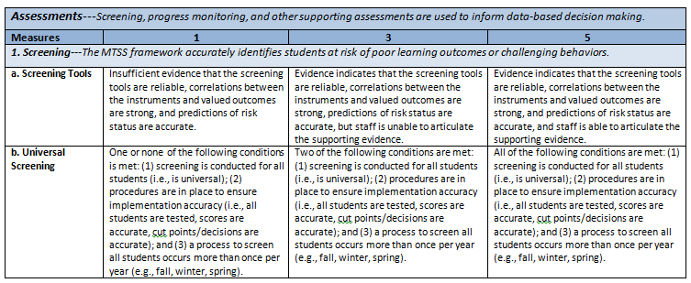
Wyoming MTSS Fidelity Rubric
Handout
1.3
Notes:
Refer participants to Handout 1.3.
An MTSS fidelity rubric is available to guide your school teams in assessing your MTSS framework components. The rubric clarifies WHAT are the criteria for implementing the components. We’ll revisit this rubric when we discuss the extension activity. It can help you answer questions.
Does our current MTSS module include all of the essential components?
To what extent are we implementing each of the essential components?
What is needed for improving implementation of the essential components?
The WDE also has developed the Literacy and Behavior MTSS Implementation Checklist. The purpose of these checklists is to support HOW to implement MTSS. We will discuss the resources later in this and other modules.
For teams not completing the Optional Team Activity—MTSS Fidelity of Implementation Self-Assessment, provide small groups an opportunity to review the contents of the resource. Have participants list where they feel they are fully, partially, or not implementing. Slide 26 provides these guided reflection questions.
A complete copy of the rubric and the implementation checklists is available in the participant workbook. An electronic copy can be downloaded here: http://wyominginstructionalnetwork.com/spdginitiatives/mtss/.

Slide 25

Optional Team Activity: MTSS Fidelity of Implementation Self-Assessment
As a team, rate the extent to which your school is implementing each criterion for the four essential components.
Handout
1.4
Notes:
The purpose of this OPTIONAL activity is to increase participants’ awareness of the essential components and connect the learning to current implementation. Ask participants to locate the Wyoming MTSS Fidelity of Implementation Rubric in their participant packet (Handout 1.4) and the activity directions. If the activity is not completed, recommend participants collaborate to complete the rubric with team members upon returning to school.
Estimated time: 30–60 minutes
Recommended Grouping: School teams.
Grouping Adaptation: If the participants are not in school teams, group individuals into 4-7 and have each member read a selection and share out with the group.
Clip art: Creative Commons

Slide 26
Reflection: MTSS Fidelity Rubric
Individually or with your team group, reflect on the following questions:
What MTSS components are implemented fully at your site?
What MTSS components are implemented partially at your site?
What MTSS components are currently absent from implementation at your site?
Notes:
Read slide.

Slide 27
Aligning MTSS With Existing Activities
Notes:
Section objective: Explain how MTSS aligns with and supports existing state and district initiatives.
Key idea:
MTSS is an overarching framework that serves to align multiple initiatives
MTSS aligns or supports all initiatives fully or in part
Provide explicit examples of alignments with state initiatives
Delivery time: 20 minutes

Slide 28

Making Connections
What connections to you see among the essential components of MTSS and existing initiatives in your school and district?
Handout
1.5
Notes:
Provide participants with 3 to 5 minutes to reflect on Handout 1.5. Next, have participants share out initiatives that connect to the essential components in small groups with an eventual large group share out.
Clip art: Retrieved from http://universdemaclasse.blogspot.com/2011/11/enseigner-les-strategies-de-lecture-un.html?_sm_au_=iVV3rrv4v2S6WLQP; Creative Commons

Slide 29
Federal Initiative Alignment With MTSS: Every Student Succeeds Act (ESSA)
Evidence-based practices have an increasingly prominent role in federal policy.
ESSA requires use of evidence-based interventions.
Notes:
Note that these are additional federal initiative examples supported by the essential components if they were not mentioned, or to emphasize if they were mentioned.
Evidence-based practices have an increasingly prominent role in federal policy. Most recently, the Every Student Succeeds Act, or ESSA, requires the use of evidence-based interventions in low-performing schools. Because evidence-based practices are a critical part of an MTSS framework, MTSS implementation is strongly aligned with the Wyoming's ESSA activities.

Slide 30
Addressing Needs of All Students
Source: PAWS and WY-Alt Results Disaggregated – State Level, http://fusion.edu.wyoming.gov/MySites/Data_Reporting/data_reporting_assessment_reports.aspx
Notes:
Prior to the session, it is recommended that the presenter include graphs (or handouts) of academic or behavior data for the target school or district. State data for several target groups are provided for discussion. The data can be accessed here, http://fusion.edu.wyoming.gov/MySites/Data_Reporting/data_reporting_assessment_reports.aspx.
Briefly review these data and discuss areas of need. Highlight how MTSS implementation can support school level initiatives for improving outcomes for all students (e.g., school improvement, equity plans).
Optional Discussion Questions:
What do you see in the data?
Are all students in Montana benefiting equally from instruction?
Emphasize how MTSS provides a systematic process for ensuring equal opportunity to increasingly intense levels of support based on need.

Slide 31

Wyoming State Initiatives
Increasing third-grade reading proficiency
  Goal: Increase to 65% of third-grade students scoring proficient or better by the end of the 2019–20 school year
Notes:
The WDE has five focus areas informed by student performance data. One of the most relevant is third-grade reading proficiency. Effective implementation of MTSS can assist the state and its districts in meeting this goal.
Review slide.
Optional discussion questions:
How is your school or district making progress toward this goal? How do you know?
Clip art: Creative Commons

Slide 32
Wyoming State Initiatives
State Systemic Improvement Plan (SSIP)
Comprehensive, ambitious, yet achievable
Multiyear
Designed to improve outcomes for children with disabilities
Uses MTSS and data-based individualization at Tier III
For more information, visit http://wyominginstructionalnetwork.com/spdginitiatives/ssip/
Notes:
MTSS framework implementation supports federal initiatives such as increasing graduation rates and the continuing certification requirements system. MTSS framework implementation also supports Wyoming initiatives related to improving outcomes for students with disabilities.
The SSIP is a comprehensive, ambitious, yet achievable multiyear plan designed to improve outcomes for children with disabilities in multiple areas: graduation, dropout, reading and math performance, transition, and early childhood. In developing the SSIP, Wyoming used data to assess the capacity of their current infrastructure to increase the capacity of local education agencies and preschools to implement, scale up, and sustain evidence-based practices. Wyoming selected MTSS with a particular focus on data-based individualization for Tier 3.
If time allows, visit http://wyominginstructionalnetwork.com/spdginitiatives/ssip/ and demonstrate where they can go for more information.

Slide 33
MTSS Team
Notes:
Session objective: Establish an MTSS team to support schoolwide implementation
Key ideas:
Purpose of school MTSS team
Recommended team members
Introduction to recommended teaming structures
Delivery time: 20 minutes

Slide 34
Effective MTSS Teams
Represent all key stakeholders
Use structures and clear processes to guide decision making
Meet regularly on a predetermined schedule
Notes:
Refer participants back to the Handout 1.3: MTSS Fidelity Rubric and have them locate the criteria for MTSS teams toward the end.
Effective MTSS teams have several key features.
Review slide.
MTSS teams collaborate to make decisions about what the best way to meet the needs of all students. Teachers begin to feel a deeper understanding of and appreciation for each other, and students benefit greatly from this team approach. In effective MTSS teams, all educators work together and are accountable for the outcomes of each and every student.

Slide 35

Successful MTSS Teams Focus on…
Student outcomes
Results not process
Prevention
Alterable variables
Smallest change
that can create the biggest effect
Evidence-based interventions
Notes:
Review slide.
Alterable Variables: Something that can be changed via instruction to increase academic or social behavior success. Examples include instructional time allocated, grouping, class size, reinforcement level, reteaching, and so on.
Evidence-Based Intervention: Additional teaching, reteaching, practice, and acknowledgment that has been demonstrated through research to impact student learning or behavior positively. This is in addition to what is provided through core instruction (including differentiation) and is selected based on data and desired outcomes.
Inalterable Variables: Something that may have an impact on students’ academic and social behavior but CANNOT readily be changed by school staff and, therefore, should not be the focus of problem-solving meetings—for example, mental health status, home life, parenting, disability status, physical or medical status.

Slide 36
Successful MTSS Teams…
Recognize adult behavior must change to support student learning and behavior effectively
Use problem solving at all levels and across academic and social behavior for students and adults
Recognize it is an ongoing process
Celebrate!
What is the problem?
DATA
Why is this happening?
Did it work?
What should be done?
Handout 1.6
Notes:
Refer participants to Handout 1.6: Overview of Wyoming Problem-Solving Process for reference only. Note that the Wyoming Problem-Solving Process will be discussed in more detail in Module 3 MTSS Essential Component: Data-Based Decision Making and future modules. A supporting document for the Wyoming Problem-Solving Process is available at http://wyominginstructionalnetwork.com/spdginitiatives/mtss/ and in the Module 3 participant workbook.
Review slide.
If time allows, provide participants 3 to 5 minutes to review and react to the Wyoming Problem-Solving Process. Optional discussion questions:
How is this process similar to the process we are currently using?
How is it different?

Slide 37
Representation of Key Stakeholders
Team Member Representation
    Administrators
    Classroom teachers (i.e., special and general education representation)
    Specialists (e.g., coaches, interventionists, English language learners)
    Family representation
  Team Knowledge and Expertise
    Data analysis and interpretation
    Content knowledge (e.g., behavior, math, reading)
    Authority to allocate resources
    Knowledge of family and community needs
Notes:
Although the exact composition of your school-level team will vary—depending on factors such as the size of your school, your student population, and your personnel—an ideal MTSS team would consist of a combination of administrators, classroom teachers, and specialists who can represent the diverse needs of your student population. Key stakeholders are those who can make recommendations and allocate resources for the group they represent. For example, the kindergarten teacher may be on the team representing all teachers, not just his or her grade.
Administrators: All teams need leadership representation on the team who can allocate resources, clarify school and district goals, and communicate with the school staff.
Classroom teachers (e.g., special and general education representation): Teacher representation provides the team with knowledge of students, classroom needs, and teacher knowledge and skills.
Specialists (e.g., coaches, interventionists): The specialists selected for the team will vary by school and district. Some schools may include the librarian because he or she will be providing interventions, and others may include their school psychologist to ensure the team has a team member knowledgeable about data analysis and interpretation.
Family representation: Communicating with families is a critical piece of MTSS. The family representative can provide input on how to communicate school and student needs effectively to families and provide content on community variables that may impact implementation.
Team members should represent not just a particular role an individual has but also what they bring to the team. It is important to ensure that at least one member on the team can provide the following:
Data analysis and interpretation
Content knowledge
Ability to understand current resources and allocate resources
Knowledge of family and community needs
Examples of specific team members are listed on the handout:
Principal
Classroom teacher(s)/grade-level representative(s)
Assistant principal(s), dean of instruction
Literacy coach and/or data coach
Reading interventionists/specialists
English language learner/bilingual specialists
Special education teachers
School psychologists, social workers, speech and language pathologists
Parents and families

Slide 38

MTSS Teams at Each Level
Must Have …
Clear purpose
Roles, responsibilities, and norms
Meeting schedule
Data sources that drive their decisions
Problem-solving process
Decision-making rules
Communication system
Notes:
Teams should use structures and clear processes to guide decision making. These must-haves listed are applicable to teams at all levels (district, school, and grade). Today we will focus on school-level teams.
Review the must-haves of MTSS teams listed on the slide.
Clip art: Stock photo

Slide 39
Purposes of School MTSS Team
Promote common understanding and vision of MTSS and communicate how MTSS components interface with current initiatives
Consider cultural and contextual needs of school population
Lead implementation of essential components
Establish a list of resources available to school and staff, including developing a menu of available interventions
Notes:
In the initial team meeting, it will be important for the team to clarify its roles in writing. This information will be shared with other school staff to ensure that there is clear communication about the purpose of the team.
A primary role of the school team will be to provide guidance to the staff and lead the thinking about how MTSS can integrate with existing systems and structures in the school. For instance, MTSS is not a separate initiative but a framework under which all initiatives can be aligned. If a school has a PBIS team, the school-level MTSS team can help streamline meetings and processes across MTSS and PBIS or combine existing teams for an MTSS team.
Here are other common purposes of the team:
Promoting a common understanding and vision of MTSS and communicate how MTSS components interface with current initiatives
Considering cultural and contextual needs of the school population
Leading implementation of essential components (e.g., establishing screening, establishing progress-monitoring protocol, determining efficacy of interventions, and making data-based decisions)
Establishing a list of resources available to school and staff, including developing a menu of available interventions
Note that there will be more content regarding teaming and the use of school, grade, and individual student data in upcoming modules.

Slide 40
Purposes of School MTSS Team
Evaluating the MTSS process at the school level
Plan MTSS professional development efforts relative to needs of staff
Determine protocol for MTSS data warehousing
Establish lines of communication
Analyze and interpret MTSS data
Notes:
Here are some other common purposes of the team:
Promoting a common understanding and vision of MTSS and communicate how MTSS components interface with current initiatives
Considering cultural and contextual needs of the school population
Leading implementation of essential components (e.g., establishing screening, establishing progress-monitoring protocol, determining efficacy of interventions, and making data-based decisions)
Evaluating the MTSS process at the school level
Establishing a list of resources available to school and staff, including developing a menu of available interventions
Planning MTSS professional development efforts relative to staff needs
Determining the protocol for MTSS data warehousing (who will enter MTSS data from screening and progress monitoring?)
Establishing lines of communication (who will communicate decisions made by school teams to the district office, school staff, parents? how will we communicate?)
Data: Screening data by grade/class/student, Progress monitoring of data by grade/class/student, Fidelity of data
Optional discussion:
What other purposes could the team serve? Are there other teams already doing some of these things that could be combine with a single team? What questions do you still have about what the team will do?
Note that there will be more content regarding teaming and the use of school, grade, and individual student data in upcoming modules.

Slide 41
Video: Wyoming MTSS Team Examples
Notes:
Video: Wyoming local education agency examples of how they lead their MTSS teams
Optional activity to supplement viewing of the video: ask participants to identify one or two aspects of the examples in the video that they could implement in their school settings. Invite participants to share out after the video.

Slide 42

Handout 1.7: MTSS Teaming Structures
Task 1: Identify team members
Task 2: Develop team norms and roles
Task 3: Establish MTSS team schedule
Task 4: Create a meeting agenda
Handout
1.7
Notes:
Direct participants to locate Handout 1.7. Review the tasks for the activity presented in Handout 1.7. Allow time for participants to work in their school teams.
If participants are not in attendance with members of their school teams, invite participants to review the document and make an action plan related to the steps when they return to their schools.
Provide groups or teams of individuals 5 to 10 minutes to complete the activity. Remind participants that they may need to finish the activity after returning to their school.
Clip art: Creative Commons; Retrieved from www.paul unay.com

Slide 43
Closing and Next Steps

Slide 44

Revisit and Think-Pair-Share
Handout
1.1
Notes:
Instruct participants to revisit Handout 1.1: Activator Activity. Provide several minutes for participants to fill in the second column (“what it is”) individually or in pairs. Solicit responses from the whole group for each and revisit slides with pertinent content as needed.
Clip art: Creative Commons

Slide 45
Handout 1.8: Resources to Support MTSS Implementation
Documents
Videos
Webinars
Tools
Training modules
General web resources
Notes:
Refer participants to Handout 1.11: Resources to Support MTSS Implementation. This document includes links to various types of resources that may assist in getting started and sustaining implementation. If time allows, review 2-3 resources.
The handout includes several types of free resources, including:
Read slide.

Slide 46
Resources: Wyoming MTSS Implementation Supports
http://wyominginstructionalnetwork.com/spdginitiatives/mtss/
Notes:
The WDE provides districts numerous resources to support MTSS implementation through the Wyoming Project WIN site. Several of the resources discussed in the module are featured on the main page.
Optional : Link to live site and demo some of the resources available if time allows.

Slide 47
Resources: Web Resources
  Center on Response to Intervention
  www.rti4success.org
  RTI Action Network
  www.rtinetwork.org
  National Center on Intensive Intervention
  www.intensiveintervention.org
Notes:
Several websites are listed here with resources that you can download, as well as videos and webinars related to MTSS.
If time allows, provide brief tours of these websites.

Slide 48
Next Steps
Complete the Module 1 quiz
Establish and convene your district/school team
Assess team knowledge of MTSS
Complete Module 2: Universal Screening
Notes:
Note that participants might also complete the extension activity.

Slide 49
For More Information
Bart Lyman
Wyoming State MTSS Coach
blyman@uinta1.com
Jennifer Hiler
Wyoming State Personnel Development Grant Program Manager
jennifer.hiler@wyo.gov

Slide 50
References

Slide 51
References
Aceves, T. C., & Orosco, M. J. (2014). Culturally responsive teaching (Document No. IC-2). Gainesville, FL: University of Florida, Collaboration for Effective Educator, Development, Accountability, and Reform Center. Retrieved from http://ceedar.education.ufl.edu/wp-content/uploads/2014/08/culturally-responsive.pdf
Burns, M. K., Appleton, J. J., & Stehouwer, J. D. (2005). Meta-analytic review of responsiveness-to-intervention research: Examining field-based and research-implemented models. Journal of Psychoeducational Assessment, 23(4), 381–394.
National Center on Response to Intervention. The essential components of RTI. Retrieved from www.rti4success.org
Dexter, D. D., Hughes, C. A., & Farmer, T. W. (2008). Responsiveness to intervention: A review of field studies and implications for rural special education. Rural Special Education Quarterly, 27(4), 3–9.
Simmons, D. C., Coyne, M. D., Kwok, O. M., McDonagh, S., Harn, B. A., & Kame'enui, E. J. (2008). Indexing response to intervention: A longitudinal study of reading risk from kindergarten through third grade. Journal of Learning Disabilities, 41(2), 158–173.

